Slide 1
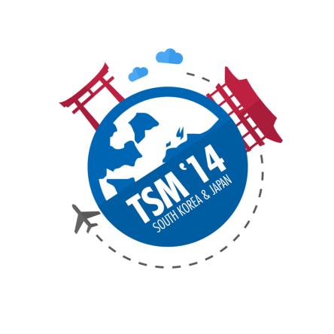
Technoprenuership study mission 2014 (Seoul/Tokyo) company Presentation
Team: AG (agurz || Glen)
Company:
ideabove (Transferred out)

Slide 2
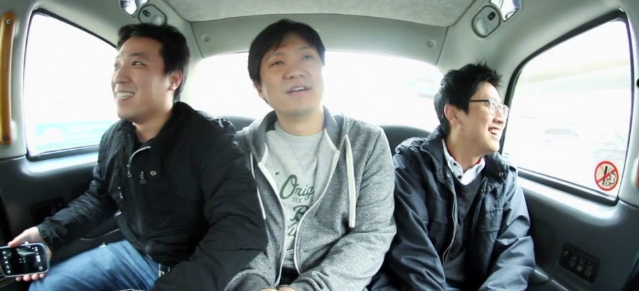
History ||
Founded 1st sept 12
Founded by simon lee, dan kang & jingu kim
Applied accelerator in london
break down language barrier
Notes:
Where did the idea for Flitto come from?
I spent half of my life in different countries where they use different languages. So I got interested in Languages. I realized many people are getting to know other languages and if we use their abilities, we could easily break down the language barrier which has been there forever
A 13 week mentor led acceleration programme based in Cambridge & London

Slide 3
Language barrier for around thousands of years
Translation market valued at $33b, annual growth of 12%
Background Industry ||
Notes:
translation market is valued at $33 billion with an annual growth of 12%.

Slide 4
About ||
Online crowdsourcing translation WEB/Mobile Application
Read social media in your native language
Translate languages in images, Voice & text
>2.5 million registered users, 170 countries, $0 marketing effort (march 2014)
Notes:
The company recently opened a branch office in Silicon Valley, California, and plans to open an office in China next month.

Slide 5
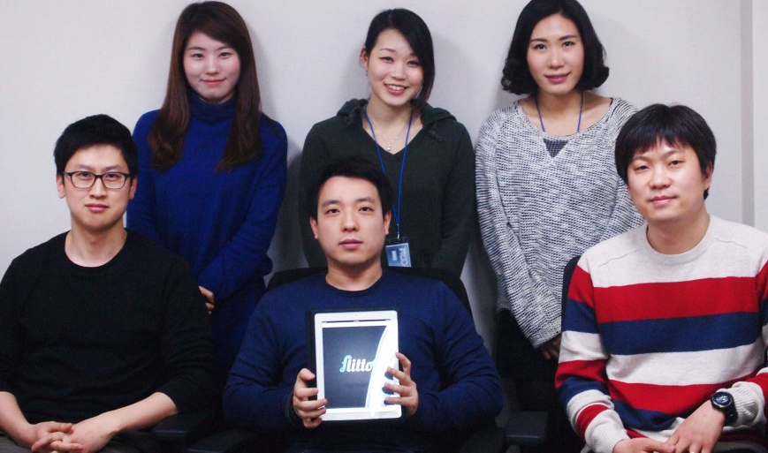
THE Team ||
Employee Size: 17
language: korea, english
(as of 25/04/2014)
Marketing/Sales: 8
Engineering Team (Front End): 3
Engineering Team (iOS/android): 3
PM: 1
Design: 2
Notes:
Country/City: background, industry, population/skill/language/culture, compare to Singapore, politics, aspiration, etc.

Slide 6
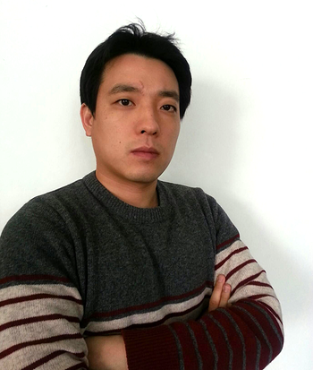
THE Team ||
CEO, Founder || Simon Lee
Notes:
2011 Manager at SK Planet
2009 Manager at SK Telecom
2007 Founder of Flying Cane – Another Startup
Korea University

Slide 7
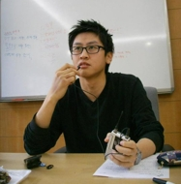
THE Team ||
CO-Founder, engineer || DAN KANG
Notes:
2011 Software Engineer @ SK Planet
2008 Manager @ SK Telecom
Yonsei university

Slide 8
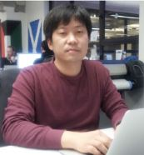
THE Team ||
CO-Founder , engineer || jinggu kim
Notes:
SK Telecom
Yonsei university

Slide 9
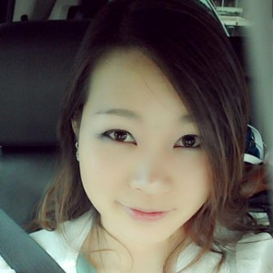
THE Team ||
Global Sales Director|| MIN HEE SONG
Notes:
Seoul University

Slide 10
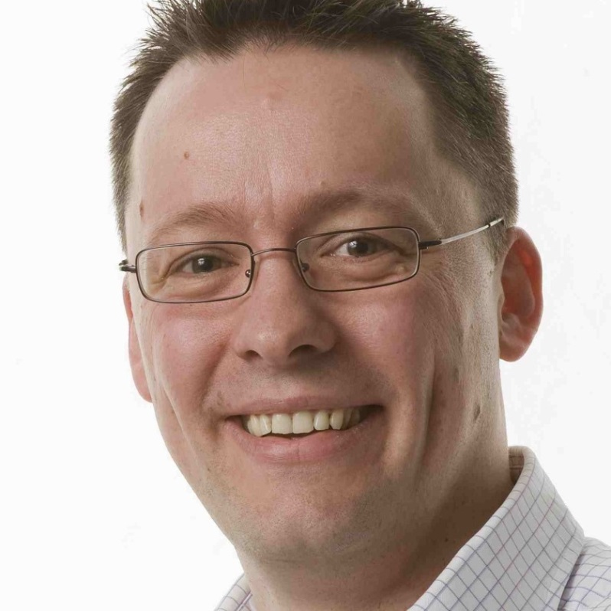
Connections ||
ADVISOR || JON BRADFORD
Notes:
Managing Director in Techstar London is the current incubator for Flitto

Slide 11
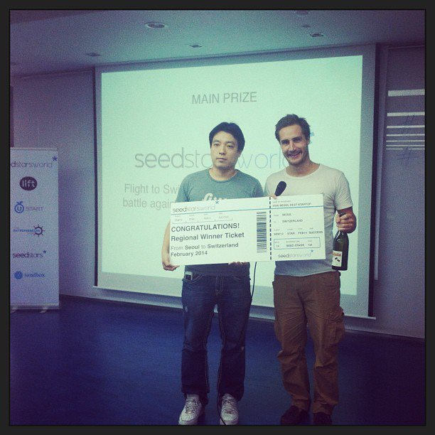
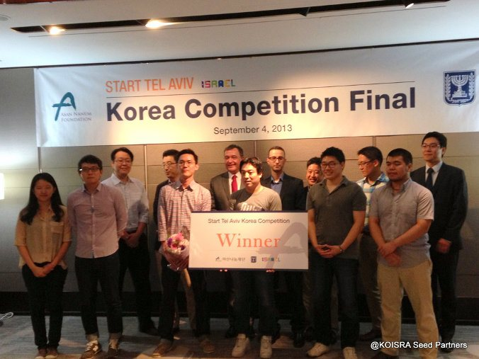
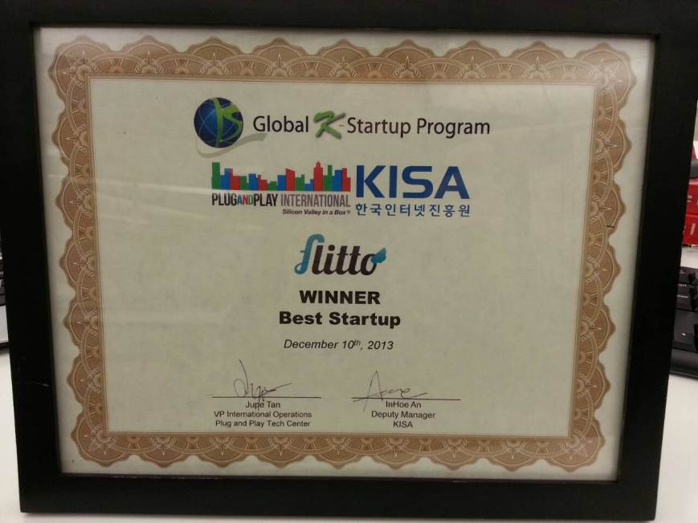
Seedstars world seoul winner 2013
Start tel aviv korean competition 2013: winner
B global k-startup program 13: winner (best startup)
Superstar M award : Winner
in Golden Pentagon: Winner
the Ministry of Science, ICT and Future Planning Award Ceremony: 1st
Mobile startup korea 13: 4th
Only Korean startup pitching at the Plug and Play Fall Expo
Top 10 companies to participate at BeGlobal
Achievements & Awards ||
Notes:
Country/City: background, industry, population/skill/language/culture, compare to Singapore, politics, aspiration, etc.
Team grew from 2 to 6 within 6 months

Slide 12
“The top 7 things you missed at SXSW”
“7 Digital Tools Discovered at SXSW to Make Your Startup Rock”
“SXSW: International Companies To Keep An Eye, Ear, And Brain On”
“Flitto, the Korean startup that uses crowdsourcing to destroy Google Translate”
“How did translation app Flitto bag the top spot at Seedstars World?”
“Simon Lee, co-founder of Flitto”
“CEO experiments crowd-sourced translation”
News ||
Notes:
http://www.bizjournals.com/kansascity/news/2013/03/15/the-top-7-things-you-missed-at-sxsw.html
http://www.nbcchicago.com/blogs/inc-well/7-Digital-Tools-Discovered-at-SXSW-to-Make-Your-Startup-Rock-199879221.html
http://techcitement.com/hardware/sxsw-international-companies-to-keep-an-eye-on/#.UyxPL1d7TVE
http://www.techinasia.com/flitto-korean-startup-crowdsourcing-destroy-google-translate/
http://e27.co/translation-app-flitto-bag-top-spot-seedstars-world/
http://www.asianentrepreneur.org/#!simon-lee/cghq
http://www.koreatimes.co.kr/www/news/people/2014/03/178_152694.html

Slide 13
user types in words or phrases that is needed for translation on Flitto and other users around the world respond. (Approx. 1 min)
Users who with the most accurate translations receive points, which are used as virtual currency on the company’s separate online shopping service.
Help merchants to bring product to the Global Market
Faster in helping business to translate
If your mom can't use it after teaching her for 10 mins, no one can use it.
Business Model ||
Notes:
http://www.koreatimes.co.kr/www/news/people/2014/03/178_152694.html

Slide 14
Matching fees
Connect requestors & translator
Takes a % from the transaction when completed
Transaction fees
Charged to translate content in flitto
Big data (transaction database sharing)
Integration with other platforms or services for a fee
Business Model ||
Notes:
http://www.koreatimes.co.kr/www/news/people/2014/03/178_152694.html

Slide 15
What Content that attracted people or translators ready to translate content?
Simon was the only translator and would spend the entire day translating tweets and pushing them to celebrities and fans on Twitter.
lack of competitors to benchmark with
Challenges ||
Notes:
http://www.koreatimes.co.kr/www/news/people/2014/03/178_152694.html

Slide 16
Provide accurate translation that even Businesses can use.
realizing dreams and creating value for people.
Motivations ||
Notes:
Organization: background, motivation, challenges, investments/employee stock ownership plan/intellectual property, strategy/business model/IPO, culture/personalities/politics/connections, etc.

Slide 17
“helping IN preservation OF languages and cultures by allowing the millions of multilingual people around the world to completely break the language barriers through translations in a dynamic, fun, and interactive way.”
MiSSion ||
Notes:
Organization: background, motivation, challenges, investments/employee stock ownership plan/intellectual property, strategy/business model/IPO, culture/personalities/politics/connections, etc.
the National Geographic Enduring Voices Project, “Every 14 days a language dies. By 2100, more than half of the more than 7,000 languages spoken on Earth – many of them not yet recorded – may disappear, taking with them a wealth of knowledge about history, culture, the natural environment, and the human brain.”

Slide 18
people to refer to Flitto when they need translations - ("just flitto it")
vISION ||
Notes:
Organization: background, motivation, challenges, investments/employee stock ownership plan/intellectual property, strategy/business model/IPO, culture/personalities/politics/connections, etc.

Slide 19
Flitto leverage the power of social media and the global community of individuals who speak more than one language to provide a translation platform that is accessible to everyone with internet access.
a platform where people can have fun by doing translations by using gamification mechanics and other incentives.
X-Factor ||
Notes:
Organization: background, motivation, challenges, investments/employee stock ownership plan/intellectual property, strategy/business model/IPO, culture/personalities/politics/connections, etc.

Slide 20
Dialects : Words can be spoken in many forms, when sending a voice recording, you can request for dialect translation
Unique Language Guidebook : Fun Sharing the language cultural of different country. E.g(Singlish)
RECOMMENDATION s||
Notes:
Organization: background, motivation, challenges, investments/employee stock ownership plan/intellectual property, strategy/business model/IPO, culture/personalities/politics/connections, etc.
Offline dictionary for the local slang?

Slide 21
The End ||
Notes:
http://www.koreatimes.co.kr/www/news/people/2014/03/178_152694.html

