Slide 1
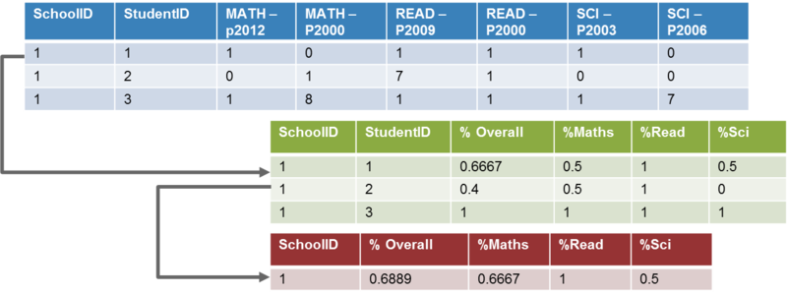
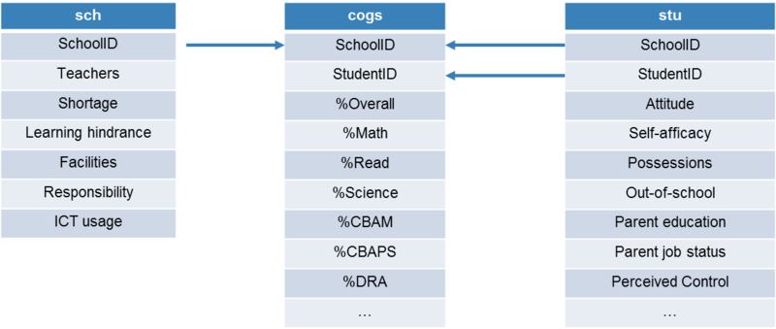
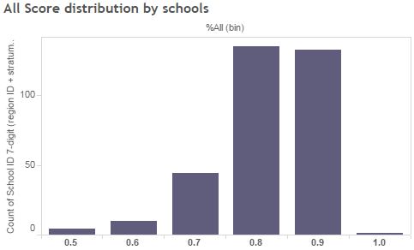
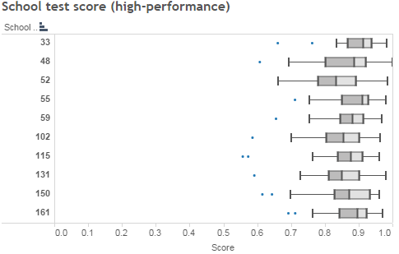
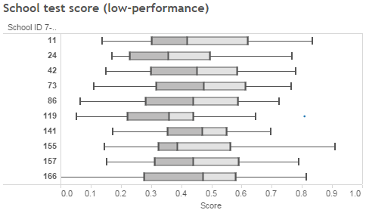
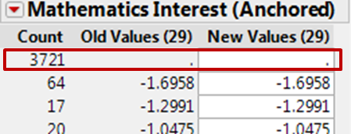
An analysis of Singapore student performance in the OECD Programme for International Student Assessment
By Team:
Nguyen Le Hong Ngoc, Poh Jin Hui, Zhao Yazhi
Motivation
Problem Statement
Data Preparation
There is an increasing need for data-driven approach to better understand Singapore education system. While Singapore is investing in analytics, education data is not yet publicly available for studies. To encourage data sharing by Singapore Ministry of Education (MOE), a proof-of-concept is required to convey the capability of data analytics to policy makers. This can be done by using publicly available alternative data sources, such as survey data collected for OECD Programme for International Student Assessment (PISA).
PISA is a international survey which aims to evaluate education systems worldwide by testing the skills and knowledge of 15-year-old students. In the absence of publicly available data from Singapore Ministry of Education, PISA data can provide insights to help managing academic performance in Singapore. The process of analysis using PISA data also serves to identify aspects of education data to focus on, or gaps in data to be fulfilled given local context. All these efforts ultimately are to incentivize MOE to make data more readily available for analysts in future.
Aggregate student test score
Count number of correct/wrong answers
Convert to percentage score for each student
Calculate average test score for each school, in each subject
Join tables:
Join sch & cogs table by SchoolID
Join stu & cogs table by StudentID and SchoolID
Results & Findings
Distribution of school score in Singapore
Distribution Analysis
High-performing schools
Low-performing schools
Data cleaning & standardization
Missing records: convert ‘I’ ‘M’ ‘N’ labels to null values
Columns in student table with more than 50% null data are excluded
Attributes that do not help differentiate entities are excluded
Decision Tree
Identify features of high vs low-performing schools using school performance as response variable
Term | G^2 | Portion
Learning Hindrance - Students truancy | 47.047 | 0.1912
Student-Teacher ratio | 26.988 | 0.1097
Index of school responsibility for curriculum and assessment | 25.842 | 0.105
Proportion of girls at school | 19.147 | 0.0778
Parental achievement pressure | 17.196 | 0.0699
Parent Participation - Progress discussion teacher initiative | 16.302 | 0.0662
Responsibility - Course content - Teachers | 11.364 | 0.0462
High-performing schools
No incidence of student truancy
Highly responsible towards curriculum & assessment
Low-performing schools
More student truancy incidents
Insufficient attention to curriculum
Lack of parent initiative to supervise child’s progress
Future Work
Explanatory Regression
Identified gaps in data
Shortages & learning hindrance could be analyzed in depth due to highly aggregated categorical data.
Unable to explain why student play truant
No details on how school fundings are used, and how they might be related to the challenges
Survey on economic-socio status needs to be customized to Singapore context
School factors
R-Square = 0.4045 | Y = Score (%All)
Parameters | Estimate | P-value | VIF
Proportion of teachers with ISCED 5A | 0.8523 | <.0001 | 1.0874
Index of school responsibility for resource allocation | 0.0368 | 0.0009 | 1.0846
Extracurricular creative activities at school | 0.0317 | 0.0041 | 1.0316
Teacher Morale | 0.0316 | <.0001 | 1.0632
Parent Participation - Progress discussion teacher initiative | -0.0007 | 0.0033 | 1.0266
Students leaving without certificate | -0.0201 | 0.0045 | 1.0412
Quality of teaching staff is most important to school performance
This is consistent when using scores in Mathematics, Reading, Science as response variables
Family and personal factors
R-Square = 0.5555 | Y = Score
Parameters | Estimate | P-value | VIF
Mathematics Self-Efficacy | 0.0532 | <.0001 | 1.3053
Miss 2 months of <ISCED 2> | -0.0354 | <.0001 | 1.0600
Classroom Management - Students Frequently Interrupt | -0.0253 | <.0001 | 1.3280
School Does Little to Prepare Me for Life | -0.0243 | <.0001 | 1.1419
Attitudes - Too unreliable | -0.0224 | <.0001 | 1.3228
Maths Behaviour - Computer programming | -0.0191 | 0.0002 | 1.1221
How many books at home | -0.0188 | <.0001 | 1.2094
ICT Availability at Home | -0.0146 | 0.0030 | 1.4248
ICT Availability at School | -0.0127 | 0.0015 | 1.1270
Recommendation
Parents with at least O-level education and stable jobs have better performing children
Student attitudes towards school and learning can override the impact of having access to resources
Detailed numeric data to be collected regarding school resources, shortage & spending
Surveys to be more directed towards student tendency to play truant
Utilize locally available data to derive economic-socio status
The special case: Even in low-performing schools, there are students who do well academically
Educational resources (books, computers) are used appropriately
Positive learning attitudes can overcome less than ideal environment

