Slide 1
Social Network Analytics
Week 11

Slide 2
Industries with little links

Slide 3
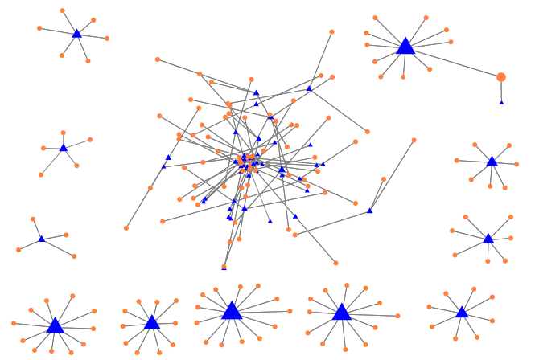
Agriculture
Oceanus Group Limited
Oceanus Aquaculture Group Pte. Ltd.
Independent Industry with only 1 overlap.
Notes:
225 entries, 166 executives, 59 companies

Slide 4
Industries with high linkages

Slide 5
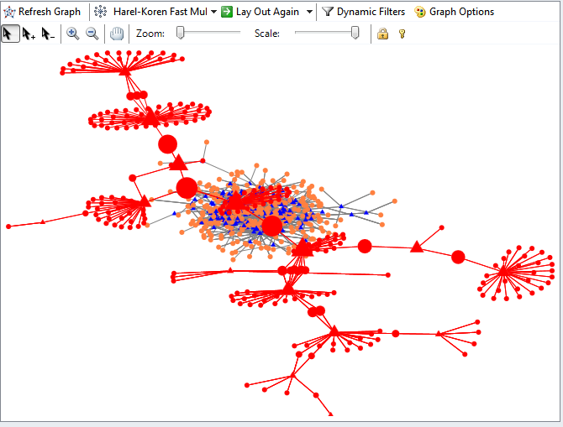
Aerospace
Bulk of industry interconnected
Notes:
882 entries, 651 executives, 231 companies

Slide 6
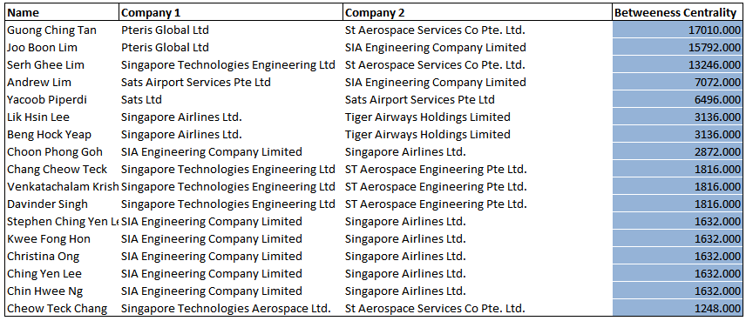
Aerospace Top Directors

Slide 7
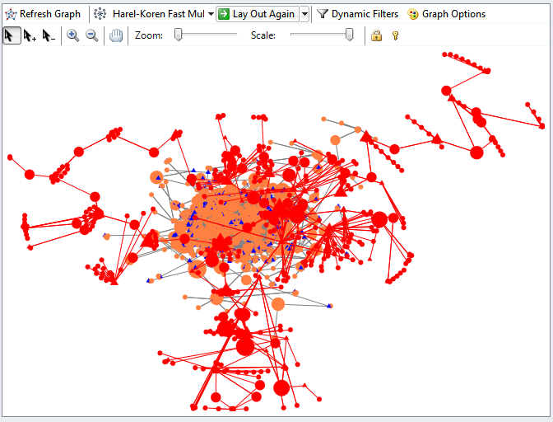
Banking
Bulk of industry interconnected
Notes:
5351 entries, 3704 executives, 1647 companies
If cut Peter Seah, Fullerton holdings, Singtel, Parkway Pantai and ISR will not be able to influence/ be influenced by the others
Top 5 people are linked

Slide 8
Bank Top Directors

Slide 9
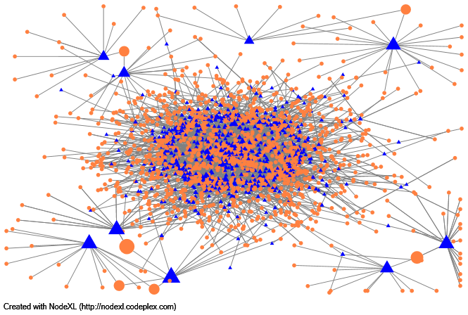
Chemicals
Influential directors spread across 4 big clusters
Notes:
Chemicals - 2660, 1753 ex, 907 coy
Bestworld-Matex-Fuyu; Jiutian-Megachem; Soxal-SingaporeOxy; GMG-China Energy

Slide 10
Chemicals Top Directors

Slide 11
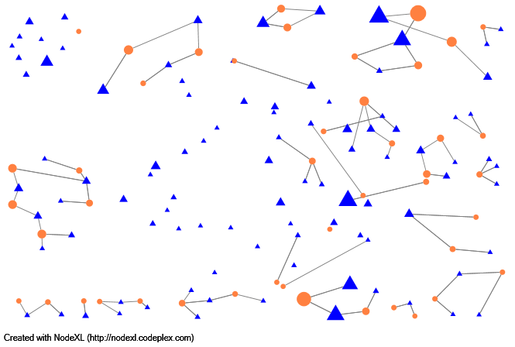
Computers
Influential directors spread across multiple clusters
Notes:
Computers - 6401, 4014 ex, 2387 coy
Trek2000-ECS;

Slide 12
Computers Top Directors

Slide 13
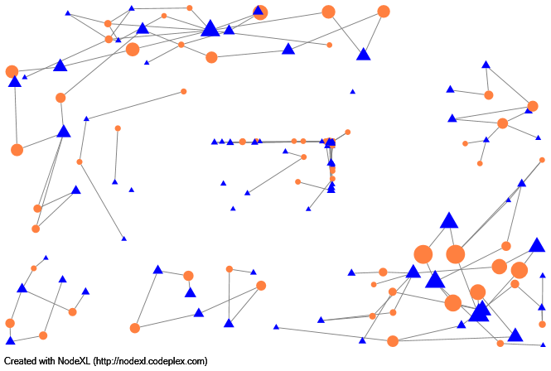
Construction
Influential directors spread across 2 big clusters
Notes:
Construction - 8425, 5362 ex, 3063 coy
Top 10 in 2 clusters (upper left, lower right)

Slide 14
Construction Top Directors

Slide 15
Company with no links (agriculture)
Company with links ( banks)
Add in number of executives & companies for each industry
Change Degree – size, Color – yellow & blue
Create table of top 5 officials and all company boards they are sitting on

