Slide 1
Network Analysis of Interlocking Directorates
ANLY 482 Practicum AY 2014/2015 Term 2
Supervised by Prof Kam Tin Seong
Le Hoang Trinh | Zheng Tianwei

Slide 2
What we have done
Learning Gephi tutorials
Merging of Company & Executive List
First visualization on Gephi

Slide 3
Visualization on Gephi
Full Network graph:

Slide 4
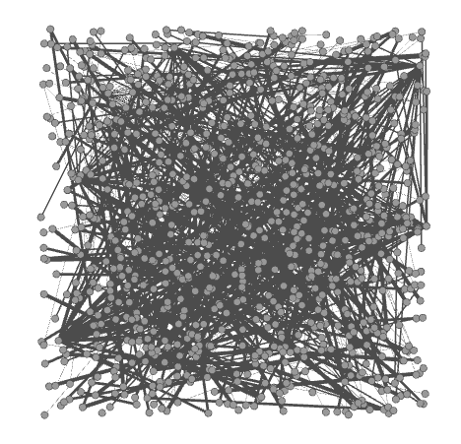
Visualization on Gephi
Aerospace & Defense:

Slide 5
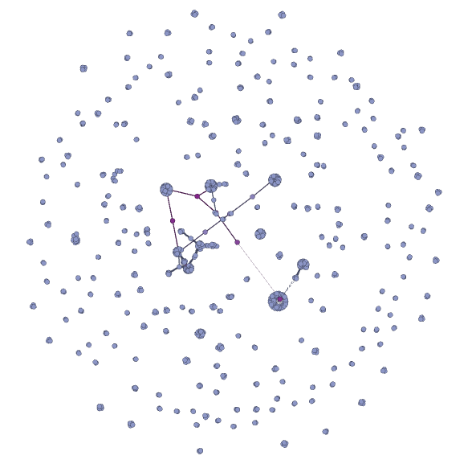
Visualization on Gephi
Aerospace & Defense:
(weighted by degree)

Slide 6
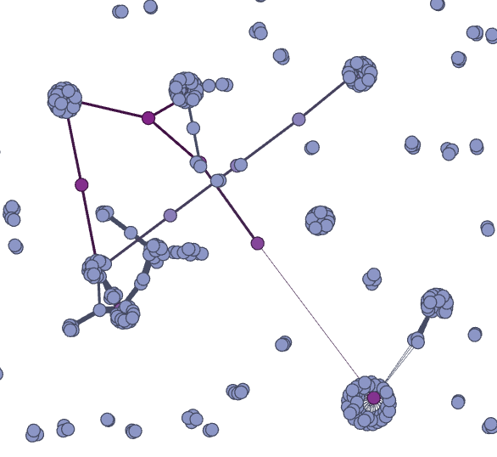
Visualization on Gephi
Aerospace & Defense:
(closer look)

Slide 7
Next week plan
Continue to study social networks metrics & Gephi functions
Revise graphs
Notes:
- Combine the Company List & Executive List to get more information & analyse the Executive List Distribution. i.e. how many CEO in each sector, how many CEO in public vs. private.

