Slide 1
Data Visualization Approach and One-Way ANOVA Analysis:
A Case Study of Li Ka Shing Library Entry Data
ANLY 482 - Group 09
Ren Mengxi, Wang Sijia, Wang Tianjing

Slide 2
Agenda
Introduction
Methodology
Data Preparation
Exploratory Data Analysis
Confirmative Analysis (ANOVA)

Slide 3
Project Introduction
Our project focuses on analyzing the library entry information from the card reader logs.
The card readers are located at the main entrance of LKSLIB and at the linkbridge side entrance.
This provides us with the entry information, which includes timestamp and basic information about the student.
In order to better understand the library usage, the library management team is interested to know whether there is any usage pattern for a particular user group (e.g. international students), and if any other business insights could be drawn from the data.

Slide 4
Methodology
The one-way analysis of variance (ANOVA):
More precise and informative interpretation of the results
Prove the insights drawn by visualization

Slide 5
Data Preparation
Data standardization
Table Concatenation
Rename columns
Missing value pattern
Recode column value
Detect outliers
Derive new columns
Entry data of library main gate and linkbridge gantry during first half of 2016 (Jan to Jun).
The whole data preparation process is fully automated using R.
After cleaning, the dataset consists of 481,648 entries generated by 8241 unique users.

Slide 6
Singaporean/
International Students
Dean’s lister/
Non-Dean’s lister
Number of Entries
Main+Linkbridge
Linkbridge
Number of Days

Slide 7
Exploratory Data Analysis
Number of students: proportionally there are more international students using linkbridge compared to Singaporean students
Number of Entries / Days: dean’s list and international students generally visit library more
All entries Through linkbridge only
The observed insights are going to be validated using ANOVA test

Slide 8
Statistical Test: One-Way ANOVA
The one-way ANOVA was used to determine whether there are significant differences between the mean of the number of entries and days by different groups of students.
The null hypothesis says that means are equal (H₀: μ ₁ = μ ₂) and we will reject or accept the null hypothesis on the basis of statistical significance (the significance level α = 0.05).
Notes:
Correlation between the number of entries and nationality and whether they are dean’s lister is statistically validated by using parametric ANOVA. The statistical data and graphs are processed with the use of Tableau and JMP. ANOVA provides a statistical test of whether or not the means of the number of entries and days made by several groups of students are equal. The one-way ANOVA was used to determine whether there are differences at the level of the entries by different groups of student.
The null hypothesis says that means are equal (H0: μ 1 = μ 2) and the alternative hypothesis says that two means are equal. The null hypothesis is rejected or accepted on the basis of statistical significance (the significance level α = 0.05).
To further find out business insights from our data, we proceed with statistical test for two levels: number of entries and number of days per student comes to the library.

Slide 9
One-way analysis for number of entries for dean’s list and non-dean’s list students for all entries
There are more non dean’s list students.
The mean of dean's list students is about 23 entries higher than the mean of non-dean's list students.
The median of dean's list students is about 22 entries more than the median of non-dean's list students.
The p-value is <0.05, which supports our visual conclusion that there are significant differences between the mean number of entries made by dean's list students and non-dean's list students, and we hereby reject our H_{0.}
Notes:
95% confidence interval
We notice that IsDeanslister = 0 has consistently lower Number of Entries than IsDeanslister = 1. We also notice that the x-axis ticks are unequally spaced. The length between the ticks is proportional to the number of Entries (observations) for dean's lister and non-dean's lister.
Mean diamonds representing confidence intervals appear: The line near the center of each diamond represents the group mean. At a glance, we can see that the mean for dean's lister and non-dean's lister looks significantly different. The mean of dean's lister is about 79 entries. The mean of non-dean's lister is about 56. The mean of dean's lister is about 13 entries higher than the mean of non-dean's lister. The vertical span of each diamond represents the 95% confidence interval for the mean of each group. We can see dean’s lister has higher interval than non-dean’s lister.
The quantiles provides overall summary information about the analysis: The median of dean's lister is about 49 entries. The median of non-dean's lister is about 27 entries. The median of dean's lister is about 22 entries more than the median of non-dean's lister.
The Analysis of Variance report shows the standard ANOVA information: The Prob > F (the p-value) is <0.0001, which supports our visual conclusion that there are significant differences between the number of entries made by dean's lister and by non-dean's lister

Slide 10
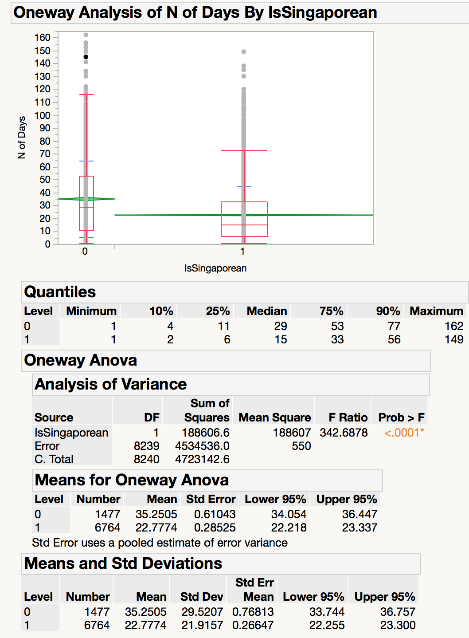
One-way analysis for number of days for Singaporean and international students for all entries
There are more Singaporean students.
The mean of international students is about 13 days more than the mean of Singaporean students.
The median of international students is about 14 more days than the median of Singaporean students.
The p-value is <0.05, which supports our visual conclusion that there are significant differences between the mean number of days made by international and Singaporean students, and we hereby reject our H_{0.}
Notes:
We notice that IsDeanslister = 0 has consistently lower Number of Days than IsDeanslister = 1. We also notice that the x-axis ticks are unequally spaced. The length between the ticks is proportional to the number of observations for dean's lister and non-dean's lister.
Mean diamonds representing confidence intervals appear: The line near the center of each diamond represents the group mean. At a glance, we can see that the mean for dean's lister and non-dean's lister looks significantly different. The mean of international students is about 32 days. The mean of Singaporeans is about 22. The mean of international students is about 10 days higher than the mean of Singaporeans. The vertical span of each diamond represents the 95% confidence interval for the mean of each group. We can see international student has higher interval than Singaporean student.
The quantiles provides overall summary information about the analysis: The mean of international students is about 35 days. The mean of Singaporeans is about 22 days. The median of international student is about 13 days higher than the median of Singaporean student.
The Analysis of Variance report shows the standard ANOVA information. The Prob > F (the p-value) is <0.0001, which supports our visual conclusion that there are significant differences between the number of days by dean's lister and non-dean's lister

Slide 11
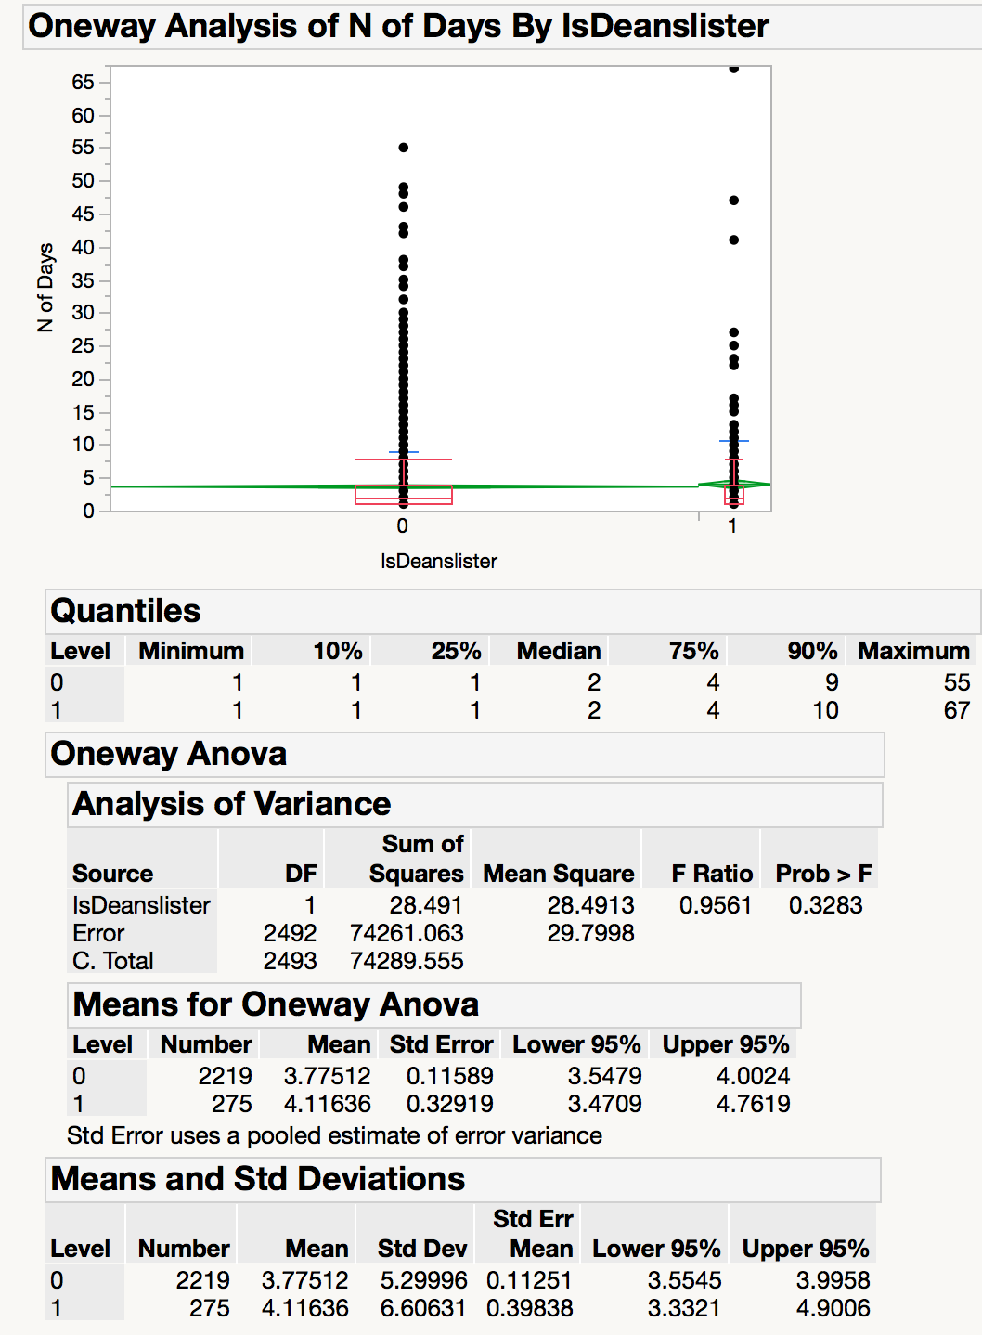
One-way analysis for number of days for dean’s list and non-dean’s list students via linkbridge
There are more non dean’s list students.
The mean of dean's lister is about 0.34 days more than the mean of non-dean's lister.
The median is same between dean’s list and non-dean's list students.
The p-value is >0.05, which means there are no significant differences between the mean number of days made by dean's list students and non-dean's list students via linkbridge, and we hereby accept our H_{0.}
Notes:
We notice that IsDeanslister = 0 has consistently lower Number of Days than IsDeanslister = 1. We also notice that the x-axis ticks are unequally spaced. The length between the ticks is proportional to the Number of Days (observations) for dean's lister and non-dean's lister.
Mean diamonds representing confidence intervals appear: The line near the center of each diamond represents the group mean. At a glance, we can see that the mean for dean's lister and non-dean's lister looks significantly different. The mean of dean's lister is about 4.1 days. The mean of non-dean's lister is about 3.7. The vertical span of each diamond represents the 95% confidence interval for the mean of each group. We can see dean’s lister has slightly higher interval than non-dean’s lister.
The quantiles provides overall summary information about the analysis: The median of dean's lister is about 2 days. The median of non-dean's lister is about 2 days.
The Analysis of Variance report shows the standard ANOVA information: The Prob > F (the p-value) is <0.33, which does not supports our visual conclusion that there are significant differences between the number of days by dean's lister and non-dean's lister

Slide 12
IsSingaporean
IsDeanslister
Number of Entries
Main+Linkbridge
Linkbridge
Number of Days

Slide 13
Thank You!

