Slide 1
Framework of Analysis
Clean data
‘cogs’ (student test score) and ‘sch’ (school survey): recoded values so that JMP Pro can recognize numeric attributes
“No-response” in ‘cogs’ table is reflected as empty cells
Aggregate
Granularity of ‘cogs’ table is test score by student; of ‘schl’ is survey response by school
Aggregate test score in ‘cogs’ table by school
Analyze
Distribution
Join ‘cogs’ and ‘sch’ by matching SchoolID
Multivariate
Segment
Identify high-performing schools and low-performing schools
Summary table

Slide 2
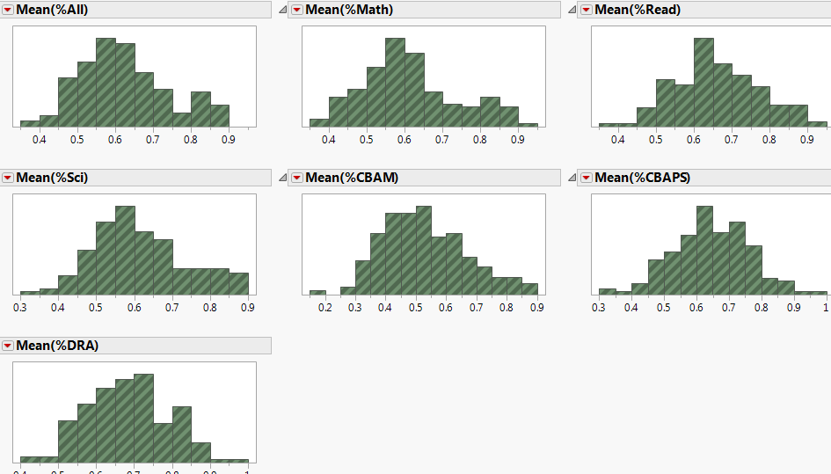
Distribution of school mean test score
Notes:
Mostly normal after data cleaning – distribution is similar

Slide 3
Correlation among subject scores
Multivariate analysis shows that the test scores for Math, Science and Reading have strong correlation, and they collectively are strongly related with Overall score

Slide 4
Finding correlations with test score
Since subject scores are strongly correlated with overall score, we focus on overall score as main measure.
Data: Joined table of ‘cogs’ (test score) with ‘sch’ (school survey results) by SchoolID
Multivariate analysis: find possible correlation between factors in ‘sch’ and test score
Distribution analysis: compare the factors between low-performing school and high-performing schools

Slide 5
Factors that are positively correlated with test score
Total enrolment (0.5984)
Student-related factors affecting school climate (0.5217)
School autonomy (0.4384)
Maths extra-curricular activities at school (0.3987)
Proportion of teacher with ISCED 5A (0.3460)
Teacher-related factors affecting school climate (0.3197)
Student Computers
Student-Teacher ratios
Teacher-related factors affecting school climate
Quality of infrastructure
Index of school responsibility for curriculum and assessment
Funding - Government
Student-Teacher ratio
Index of school responsibility for resource allocation
Quality of infrastructure and Quality of educational resources
Student-related factors affecting school climate
Notes:
(*) ISCED 5A means tertiary and post-graduate education level
Negative correlations are mostly weak, with -0.2 or less
These can potentially be used to build a regression model. But we think the correlation is still a bit weak among attributes in their raw form.
Identifying the factors that are correlated with test score, then drill down further to identify other factors that are correlated to them → ways to improve test score by boosting these factors.

Slide 6
Profiling the schools
Use Summary table to calculate means and standard deviation in test score for every school
Separate the schools that satisfy the following criteria in terms of mean test score
Up to 25th percentile → low-performance schools
75th percentile and above → high-performance schools
Notes:
Initial thought: clustering – not necessary since the only criteria is Overall score. Taking the percentile will work just as well.

Slide 7
Low-performing vs High-performing
Lower quality of educational resources
Lower Student-Teacher ratio
Poor student-related factors affecting school climate
Lower teacher focus and morale
Lower no. of computers for education per students
Higher index of responsibility for resource allocation
Lower math professional development for staff & math teachers
Teacher initiate discussion more often, concerning progress and behavior of students
High quality of educational resources
High Student-Teacher ratio
Good student-related factors affecting school climate
High teacher focus and morale
Higher no. of computers for education per students
Lower index of responsibility for resource allocation
Lower math professional development for staff & math teachers
Parents initiate discussion more often, concerning progress and behavior of students
Notes:
This is done using distribution analysis w frequency school ID and group by clusters.
How to more reliably compare distribution of factors? How to really conclude that the mean values for the factors differ from 25th and 75th percentile?

Slide 8
Similarity between 2 profiles
Very low teacher autonomy
Schools are not short of teaching staff according to survey
Girls’ school either perform really well or really poorly
High proportion of certified teachers
High proportion of math teachers with tertiary education and above

Slide 9
Upcoming tasks
Review framework of analysis
Student-level analysis

