Slide 1
Supervisor meeting
Progress update
1 April 2016

Slide 2
Recap from previous meeting
Distribution analysis
Right-skewed normal distribution for student test scores
Student scores better in Maths, Reading and Science compared to Computer-based problem solving
Segmentation analysis
Identified features of low-performing and high-performing schools
To-do: Implement cluster analysis by component scores
Multiple regression
School-level: analyzed numeric attributes and effect on test scores
To-do: student-level analysis and exploring categorical attributes in dataset
Sponsor’s feedback
Visualization for distribution analysis, reflects descriptive statistic of test scores for each school
Show distribution for relevant attributes (eg. no. of full-time, part-time teachers, certified teachers, etc)
Allow drill-down from school to student level

Slide 3
Distribution Analysis
Tableau dashboard
Data:
School: student test score, full-time vs part-time teachers, proportion of certified teachers
Student: parents education, job status, economic index and access to ICT

Slide 4
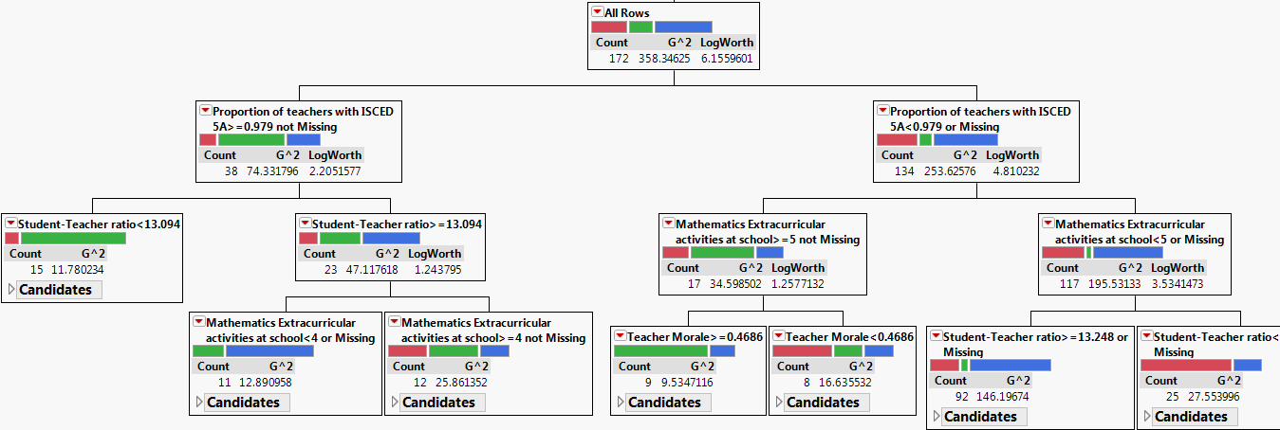
Segmentation analysis
Cluster the schools by test scores
Partition analysis with the clusters as outcome
Red: low-performing schools
Green: high-performing schools
Notes:
Show cluster analysis result first. Include cluster label
Workflow for analyzing student performance at school level
K-means or hierarchical clustering
Report missing value patterns

Slide 5
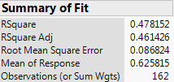
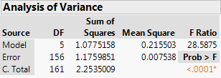
Analyzing performance at school level
Multiple regression: categorical attributes analyzed and combined with numeric attribute
Notes:
Dummy variable – in partition, split by cluster, not by score
Loading into regression model – still use score as outcome
Report the results for all the models: Overall score, Math, Sci, Read, CBAM etc → compile results in a table (Rsquare, Adjusted Rsquare, Estimate, p-value)
→ Should include a list of independent variables that affect the response variable (all the factors picked, not only those that are significant. Report values for only significant variables)
Aim: compare the factors and their effect

Slide 6
Analysis on Resource constraints
How does resource constraint affect school performance?
Data: Shortage-related attributes from school data
Shortage of Science teacher is the most prominent, with 27.1% of the schools reported moderate degree of shortage
Multiple regression shows no evidence that shortage of resources affect school performance in Maths, Science and Computer-based tests
However, Partition analysis shows the top few shortages that differentiate school test scores
Notes:
Be careful with variable selection.
First, examine all the relevant variables (stats and literature review) → if some of the variables don’t show up as sign, can zoom in

Slide 7
Analysis on Resource constraints
For Math: heating/cooling and lighting; language & science teachers; library materials; computer for instructions
For Science: library materials; math teachers; heating/cooling and lighting; internet connectivity; computer for instructions
For Computer-based: Internet connectivity; Maths teachers; Library materials; Instructional space

Slide 8
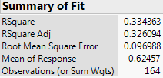
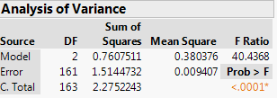
Analysis on Learning hindrances
What are the major learning hindrances for schools in Singapore? To what extent do they affect student performance?
Data: Learning Hindrance from school data
Student truancy and disruption are the 2 major learning hindrance that negatively affect school performance

Slide 9
Analysis on Learning hindrances
Red: low-performing schools
Green: high-performing schools
Blue: schools with average performance

Slide 10
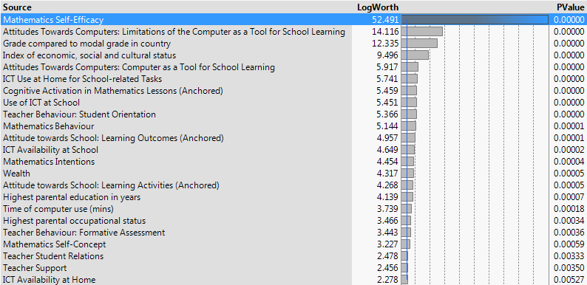
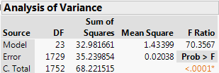
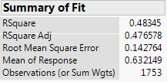
Analyzing performance at Student level
Multiple regression: numeric data in student table

Slide 11
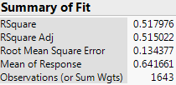
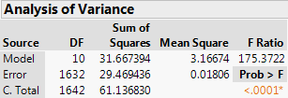
Analyzing performance at Student level
Multiple regression: categorical data in student table
Notes:
Data regarding student is very rich, but not sure what business questions to explore/ how to make analysis deeper
Review variable selection – exclude those w high missing values %
Partition of student variables can be done using mean score (don’t need to cluster prior to that)
School-level: if use mean score, it’ll be means of the means that we use for splitting, not ideal

Slide 12
Analysis on student home environment
Students having more books at home score better than their peers without or with few books.
Access to computer caused the student performance to be more extreme (for better or worse)
Generally, students with better economic background scores significantly better
Take into account that score distribution is right-skewed

Slide 13
Questions from the team
Visualization of findings
Multiple regression
How to tell a good story
Improve goodness of fit for regression model
Build more in-depth analysis
What constitutes student tendency to play truant?
Various areas of Math/ Sci/ Computer-based
Notes:
How much descriptive analytics should be included? Reports on English and Portugal education seems purely descriptive of survey data.
Put findings in Dropbox

