Slide 1
Network Analysis of Interlocking Directorates
ANLY 482 Practicum AY 2014/2015 Term 2
Supervised by Prof Kam Tin Seong
Le Hoang Trinh | Zheng Tianwei

Slide 2
What we have done
Revision of Proposal
Cleaning of Companies List Data (after feedback)
Cleaning of Executive List Data
Creating Executive Distribution

Slide 3
Company List Data
Feedback from last week:
Lack of registered year & postal code column
Company List still has duplicates
The company categorises are too detailed
Team Fix:
Added “Year founded” and “Postal Code” columns
Check and remove duplicates. Unique values remain: 50676 companies
Add “Category” column next to “OneSource Industry” column to classify broader category

Slide 4
Executive List Data
Issue:
Duplicated Executive Title
Too many titles for COO, CFO, etc.
Team Proposed Fix:
Check the title definitions
Create “Category” column to group the main executive titles together
Group titles under “C-level”

Slide 5
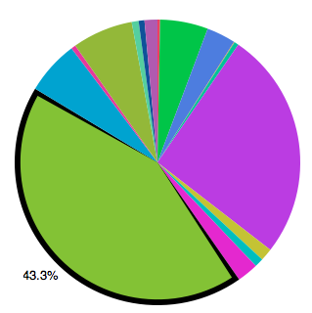
Executive Distribution
By Category
Highest distribution:
Managing Director: 43.3%
Director: 25.9%
Owner: 6.9%
Notes:
BOD
Chairman (3.2%)
Vice Chairman (0.6%)
Executive Director (2.3%)
Non-Executive Director (0.5%)
Director : Unclassified directors, Board Members (25.9%)
Function/Operations Team
CEO (5.4%)
Deputy CEO (0.07%)
Managing Director (43.3%)
Deputy Managing Director (0.4%)
C-Level : Senior partners and all other Chief Officers excluding CEO (0.2%)
President (0.7%)
Vice President (1.4%)
Division Head : Partner, GM, Director with descriptive element (1.4%)
Owner : Owner, Founder, Proprietor, Partner (6.8%)
Miscellaneous : School Principals, Other executives (6%)

Slide 6
Next week plan
Continue to analyse Executive List Distribution
Consolidate current findings
Prepare mid-term report & presentation
Notes:
- Combine the Company List & Executive List to get more information & analyse the Executive List Distribution. i.e. how many CEO in each sector, how many CEO in public vs. private.

