Slide 1
Network Analysis of Interlocking Directorates
ANLY 482 Practicum AY 2014/2015 Term 2
Supervised by Prof Kam Tin Seong
Le Hoang Trinh
Zheng TIanwei

Slide 2
Meeting Scope
What we have done
Outstanding issues
Overview of Company Distribution
Week 6 Scope
Questions

Slide 3
What we have done
Crawl Raw Data from OneSource
Company Dataset: 87664 entries
“List of Companies_Complete.xlsx”
Executive Dataset: 110065 entries
“List of Executives_Full.xlsx”
After processed
Company Dataset: 40824 entries
Because of duplicates in executive entries
“List of Companies_NoDuplicate.xlsx”
Executive Dataset: 110065 entries
“List of Executives_RemovedDupTitles.xlsx”

Slide 4
What we have done
Missing Data from Parent Company & Country
~50% entries missing
Proposed Fix
Performed Internet search to find missing entries
If found, add it to data set
If no results,
Assume no parent company/country, enter company name/ Singapore respectively (Chosen)
Delete data with missing field
Notes:
We did not choose the path of deleting the data with missing fields because too much data was at stake.
Also, the assumption we made was statistically logical since most of the fields were left blank by OneSource because the companies were domestic SMEs.

Slide 5
What we have done
Inconsistency in Executive Title and Executive names columns
Check and replace Executive titles & names to have more consistency
Followed the hierarchy levels as seen in http://www.hierarchystructure.com/board-directors-corporate-hierarchy/

Slide 6
Company Distribution Overview
Distribution by parented company and ultimate parented company
Highest Distribution: Singapore, US, Japan

Slide 7
Company Distribution Overview
Distribution by industry
Highest Distribution:
Wholesale (23.2%)
Manufacturing (18.1%)
Business & Mgmt Services (9.7%)
Notes:
Miscellaneous Wholesale
Consulting Services
Machinery Wholesale

Slide 8
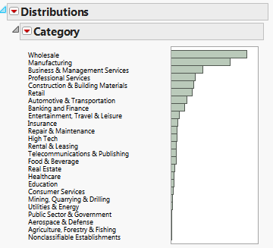
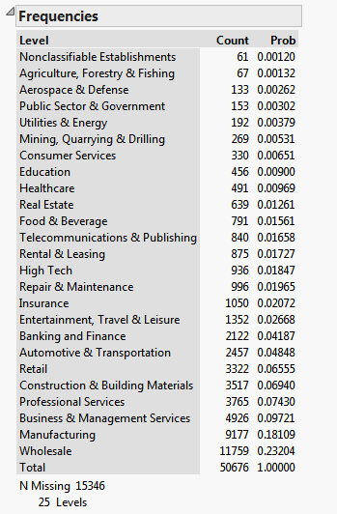
Notes:
Top 3 Industries – Wholesale (23.2%), Manufacturing (18.1%), Business & Management Services (9.7%)

Slide 9
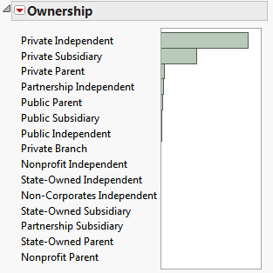
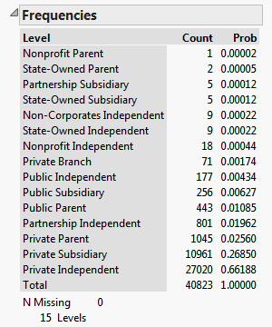
Company Distribution Overview
Distribution by ownership
Notes:
Private Independent makes up nearly 67% of the population, followed by
Private Subsidiary making up nearly 27%
From the data, we can see that public companies are a very small population of the dataset, making up only about 2% of the entire population when combined

Slide 10
Next week Scope
Distribution Analysis of Executives
Initial analysis of executives and companies connection between/within industry

Slide 11
Appendix
Raw Data
List of Companies_Complete.xlsx
List of Executives_Full.xlsx
Processed Data
List of Companies_NoDuplicate.xlsx
List of Executives_RemovedDupTitles.xlsx
List of Companies_NoDup_ParentFilled.xlsx

Slide 12
Appendix
Distribution Data.jmp
Distribution_Pcountry
Distribution analysis of company data according to parent and ultimate parent country
Distribution_Industry
Distribution analysis of company data according to industry classifications
Distribution_Ownership
Distribution analysis of company data according to ownership classifications
*JMP based on “List of Companies_NoDup_ParentFilled.xlsx”

