Slide 1
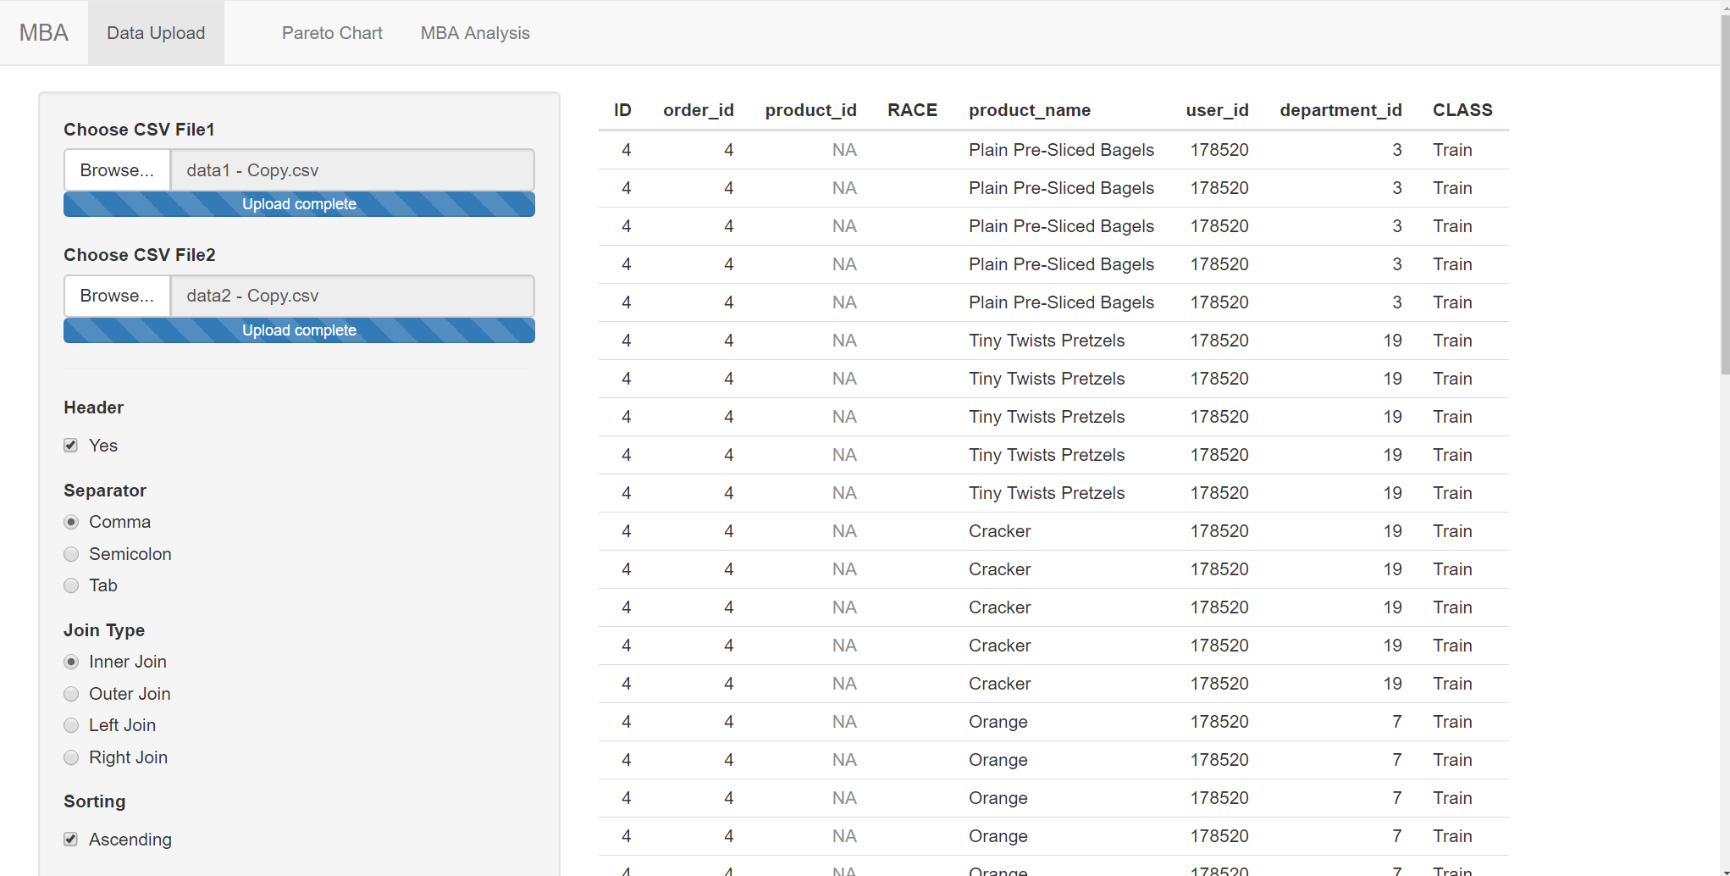
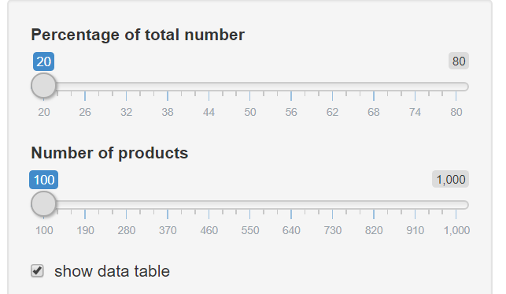
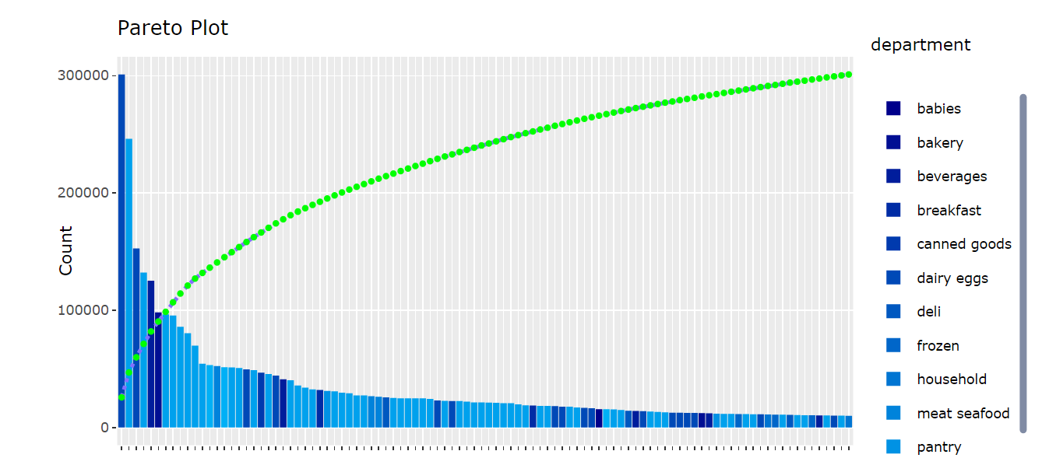
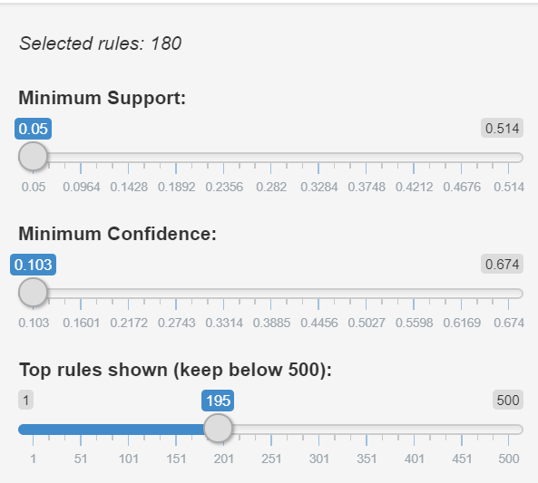
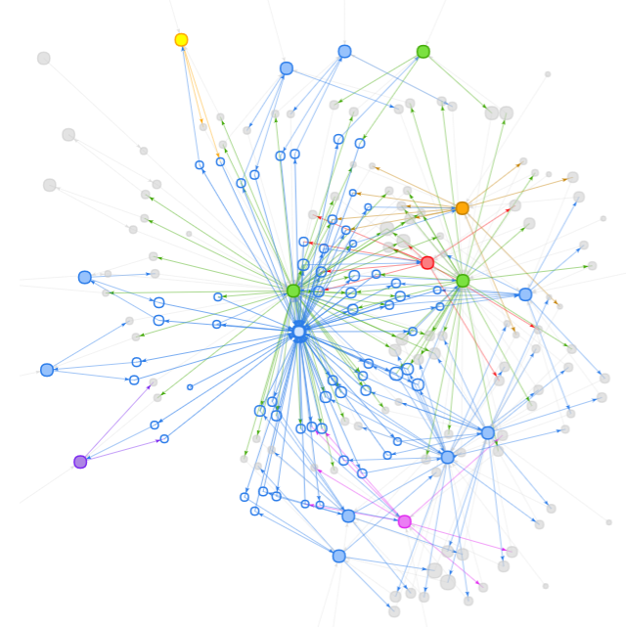
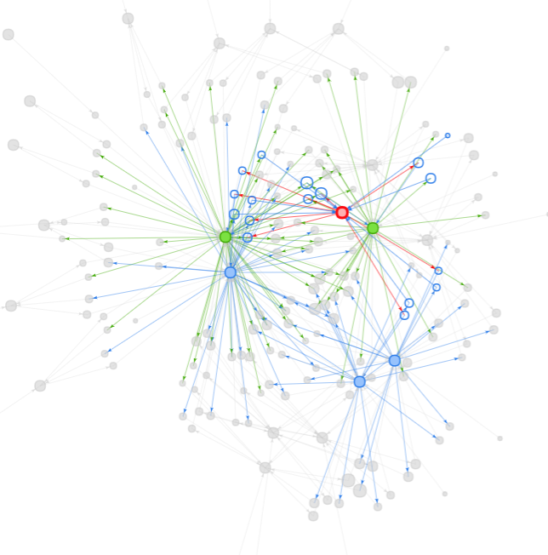
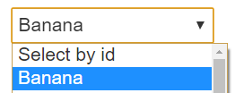
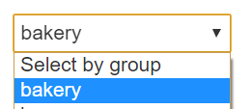
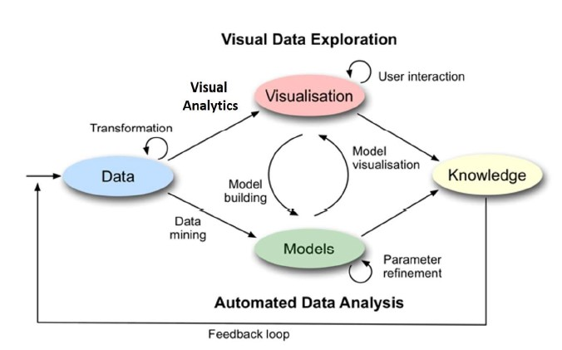
Grocery Maze
- Navigating through Grocery Maze By using Interactive Network Visualization
Jun Haur LOK, Xingwen WANG, Shifeng XU
Network Visualization
Introduction and Motivation
Network visualization, graph visualization or link analysis is the process of visually presenting networks of connected entities as links and nodes.
In this era of information explosion, this poses challenges in continuing the current conventional way to analyze association rules. Often these conventional methods do not show the underlying complex relationships between different items. Besides that, the conventional interface of the analytical software lack of interactivity between the graphs and the underlying model.
Our motivation was sparked by a general lack of interactivity in the way of analyzing association rules and lack of interactivity in model building and the relevant visualization.
Hence, in this research, an alternative way to visualize the association rules is presented. Demonstrations are also included to show interactivity functions are integrated into the application to provide a more seamless process in calibrating the model and visualizing the association rules. The designed application will provide users more control and flexibility.
Motivation
R ShinyApp
PPT
R-Shiny is used to build our dashboards to achieve the outcome and gives the audience a deeper and better insight through our powerful, flexible and interactive dashboards. R packages used: dplyr, tidyverse, arules, arulesViz,DT, visNetwork, igraph, arulesSequences, stringr, tidygraph, ggraph, plotly,shinythemes
Data Cleaning, Prep & Upload Function
Data Understanding & Cleansing
Select Most Frequent Product
Input tab to upload data
Acquired data from the Kaggle and perform join between transaction and product master file.
Summary the data by product and select the most frequent product purchased by customer
Data is extracted from Kaggle with more than 30 million lines of transactions. It contains products data, order details and department data.
Data prepared for network visualization by recode, sampling, joining , summarization and combination.
The visualisation gives the user flexible to upload data and merge with secondary data for analysis.
1
2
3
4
Recode the Product
Final Combination
Group the products by its natural and product similarity for better MBA result
Combine the Train and Prior data for the network analysis
Data Visualisation
Pareto Chart Analysis by Products Quantity Sum and Percentage
The design of the visualization follows the following mantra by Shneiderman B.:
“Overview first, zoom and filter, then details on demand”
Pareto chart helps users to understand overall view on the distribution of product sold. This visualization helps user to know what are the top sales items in the transaction data.
With pareto chart, the company can pick product combinations that do not have too low sales and with good measurements such as lift.
Highlight functions are also included into the visualization to allow the users to highlight a certain product or department to facilitate the analysis as shown on the screen shot on the right.
The interface design of the application also made reference to model building process covered in Week 1 lecture note of Visual Analytics and Applications by Professor Kam Tin Seong.
For example, the conventional interface of the analytics software would require the users to go back and forth between the model and visualization if parameters need to be updated.
So to resolve this, parameters are included beside the visualization. This would allow the users to be able to calibrate the model on the fly.
Network Visualizations by Product Name and Department
Conclusion and Future Work
In this paper, we have demonstrated how we have used ShinyApp and network visualisation to draw insights from the association rules. This would help the companies to have a better understand how the different items are ‘related’ to one another. The companies would know how they would like to cross-sell or up-sell the products in order to boost the product sales.
Nevertheless, the network graph used in this research paper is not the only type of network graph. The design could further improve by trying different network graphs so we can compare the different types of the network graph. Crosstalk function could be added to the application to link the graphs together. This would enhance the user experience as well.

