Slide 1
Gateway to the Future
A User Guide for
R Shiny Analytics Tool
using
Singapore Management University’s
Library Survey Data

Slide 2
Contents
Section | Page
Overview & Walkthrough | 3
Navigation Sidebar | 4
Panel 2: Demographic Exploration Pane-Sunburst Chart | 5
Panel 2: Demographic Exploration Pane-Sunburst Chart | 6
Panel 2: Demographic Exploration Pane-Donut Chart | 7
Panel 2: Demographic Exploration Pane-Grouped Bar Chart | 8
Panel 2: Visualisation - Divergent Stacked Bar Chart | 9
Panel 3: Visualisation - Dumbbell Plot | 10
Panel 3: Visualisation - Heat Map Plot | 11
Panel 3: Visualisation - Upset Plot | 12
Panel 4: Modelling - Principle Components Analysis (PCA) | 13
Panel 4: Modelling - Analysis of variance (ANOVA) | 14

Slide 3
Overview & Walkthrough
Introduction
Application landing page
Demographic
Sunburst Chart shows the demographic breakdown of respondents.
Donut Chart shows the split users between 2 libraries and whether they are on international exchange.
Grouped Bar Chart shows the frequency of the visitors to different libraries and campus resources.
Visualisations
Divergent stacked bar charts show sentiments of respondents for various survey items
Dumbbell plots show library performance on item parameters compared to their importance ratings.
Heat maps show the proportion of ratings given by respondents from different areas of study/research.
UpSet plots show the grouping of respondents according to user defined parameters.
Modelling
Principal components analysis shows how items may be related to each other
ANOVA analyses whether difference in the means ratings given for each category by respondents are significant.
About
A overview of and motivation behind the project, the data, authors and acknowledgements.

Slide 4
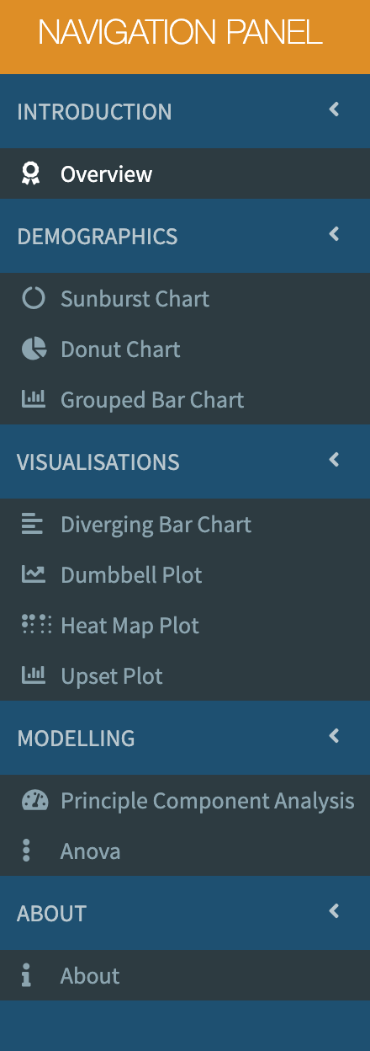
Navigation Sidebar
Instructions for Use:
Collapsed View: 5 main headers are present in the navigation panel as shown in the adjacent figure (Fig 1).
In order to navigate, the user needs to click on the corresponding tab.
Expanded View: Once the user has clicked the options appear as shown in Fig 2.
The user has to click on the options provided to see the associated page display in the R Shiny application.
Fig 1. Collapsed View
Fig 2. Expanded View

Slide 5
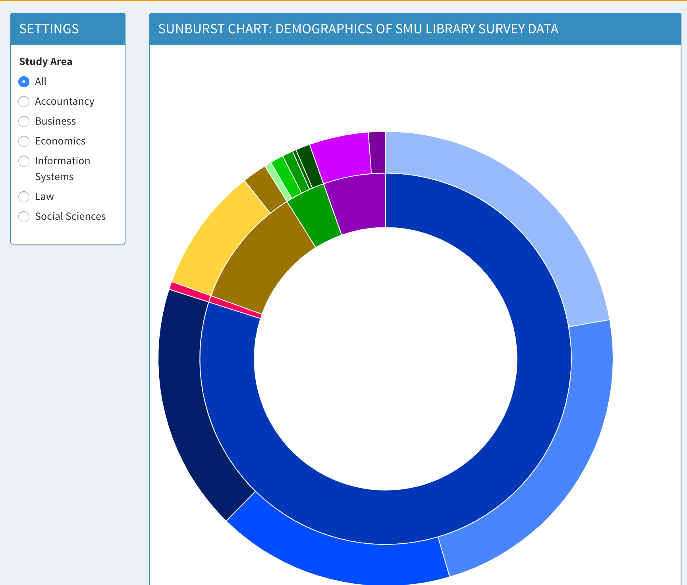
Demographic Section - Sunburst Chart
Instructions for Use:
Once the user clicks the ”Sunburst Plot” in the navigation panel the shiny app loads the default page as shown in the adjacent fig 3.
The user needs to hover over the chart to see the split of the demography of the respondents.
The different options listed under the study area helps the user the slice the demography and see as per the Major study area
By default when the page loads the Option “All” is selected
Fig 3. Sunburst Chart

Slide 6
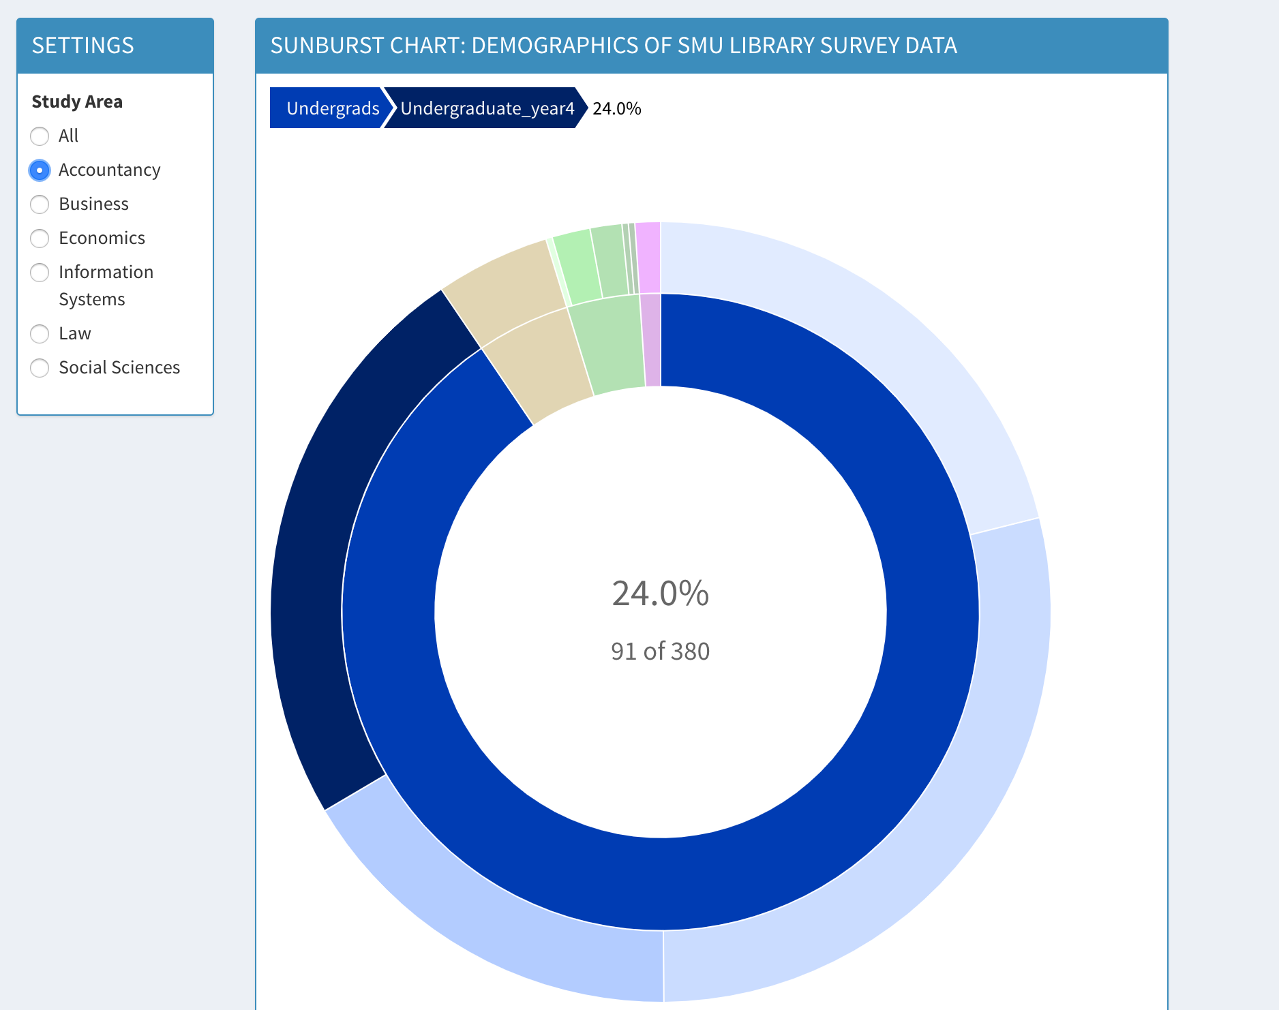
Demographic Exploration - Sunburst Chart
Instructions for Use:
Once the user has selected one of the study area then the plot automatically updates reflecting the demographic split for that study area
As the user hovers the graph, the split of the corresponding selection appears.
For e.g. here the user has the mouse pointer over the outer navy blue ring which represents the undergrad who are in year 4.
From the graph it can be inferred that there are total 380 respondents from the Accountancy study area out of which 91 is from undergrad year 4.
This selection accounts to 24% of the total responses from the Accountancy study area
Fig 3. Sunburst Chart

Slide 7
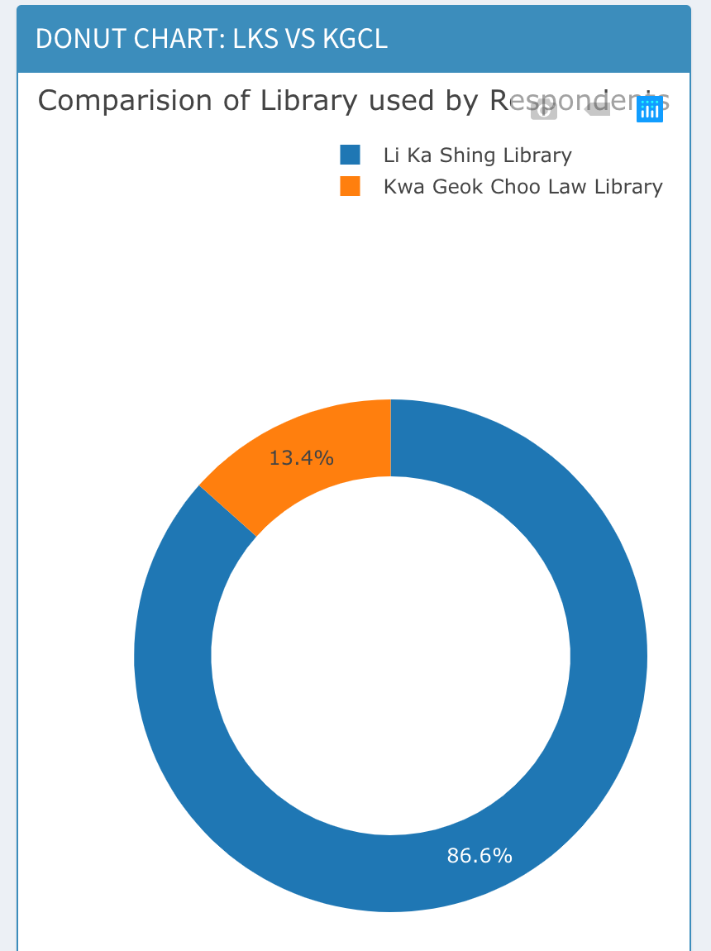
Demographic Exploration - Donut Chart
Instructions for Use:
Fig 5. Donut Chart tool
Hover over the donut chart to see the value
There 2 Donut chart showing the split of the respondents and the library preference.
The top left portion as shown in Fig 5 has tools where you can save the chart by clicking on the camera symbol.
Fig 4. Donut Chart

Slide 8
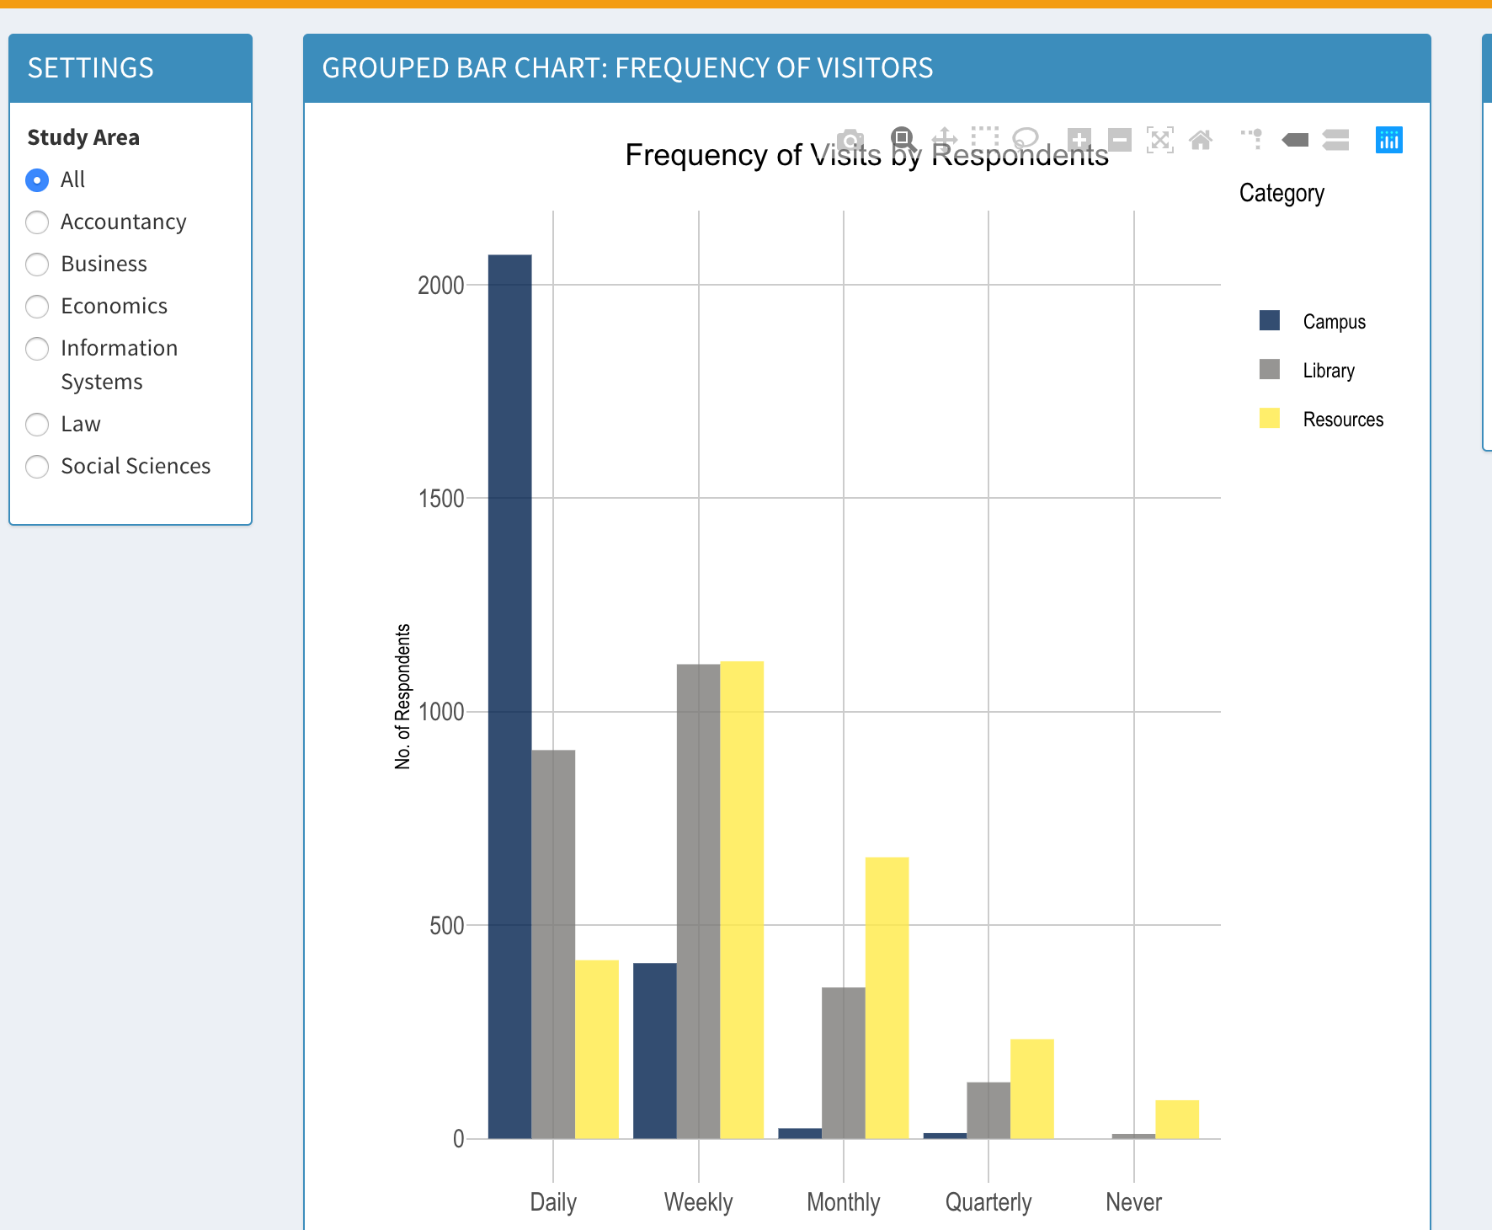
Demographic Exploration- Grouped Bar Chart
Instructions for Use:
Fig 7. tools of the chart
This grouped bar chart shows respondent numbers grouped by frequency of visits
Hover over the chart to see values
Click on left to slice and dice according to major area of study
The top left portion as shown in Fig 5 has tools where you can save the chart, zoom, pan and lasso select etc.
Fig 6. Grouped Bar Chart

Slide 9
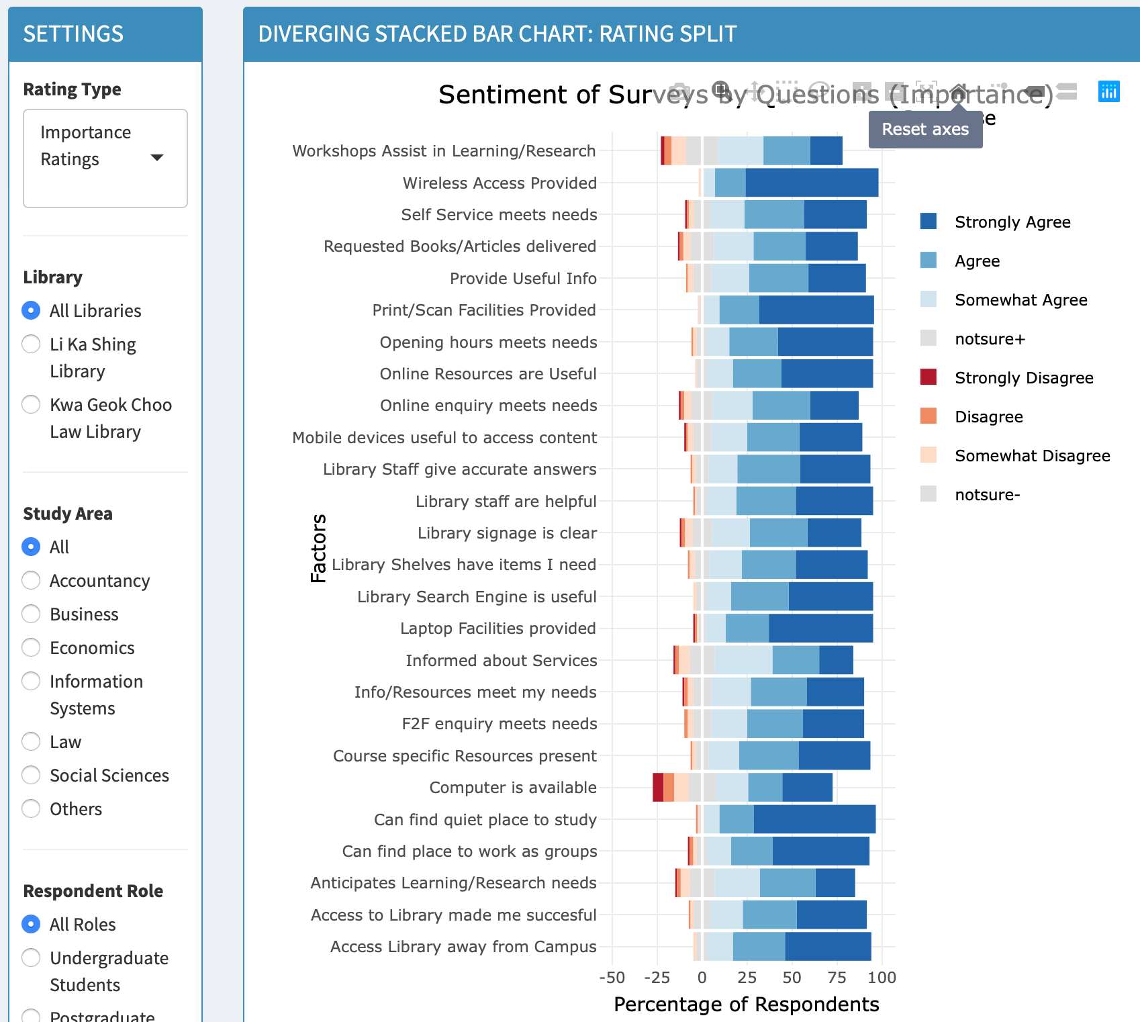
Visualisation - Diverging Bar chart
Instructions for Use:
This chart explains the overall sentiments of the respondents for each questions
This is a diverging bar chart. Hover over the chart to see values.
Click on left to select the type of Library, study area and the type of respondents.
Filter according to see between Performance and Improvements ratings.
Fig 9 Instructions
Selecting Points – as highlighted in Red box
Zooming in and out of boxplot – as highlighted in Blue box
Graph Inferring Aids – as highlighted in Green box
Resetting Selection -To reset and remove selected markers from the chart, user can double click at any blank spaces available within the chart
Fig 8. Grouped Bar Chart
Fig 9. tools of the chart

Slide 10
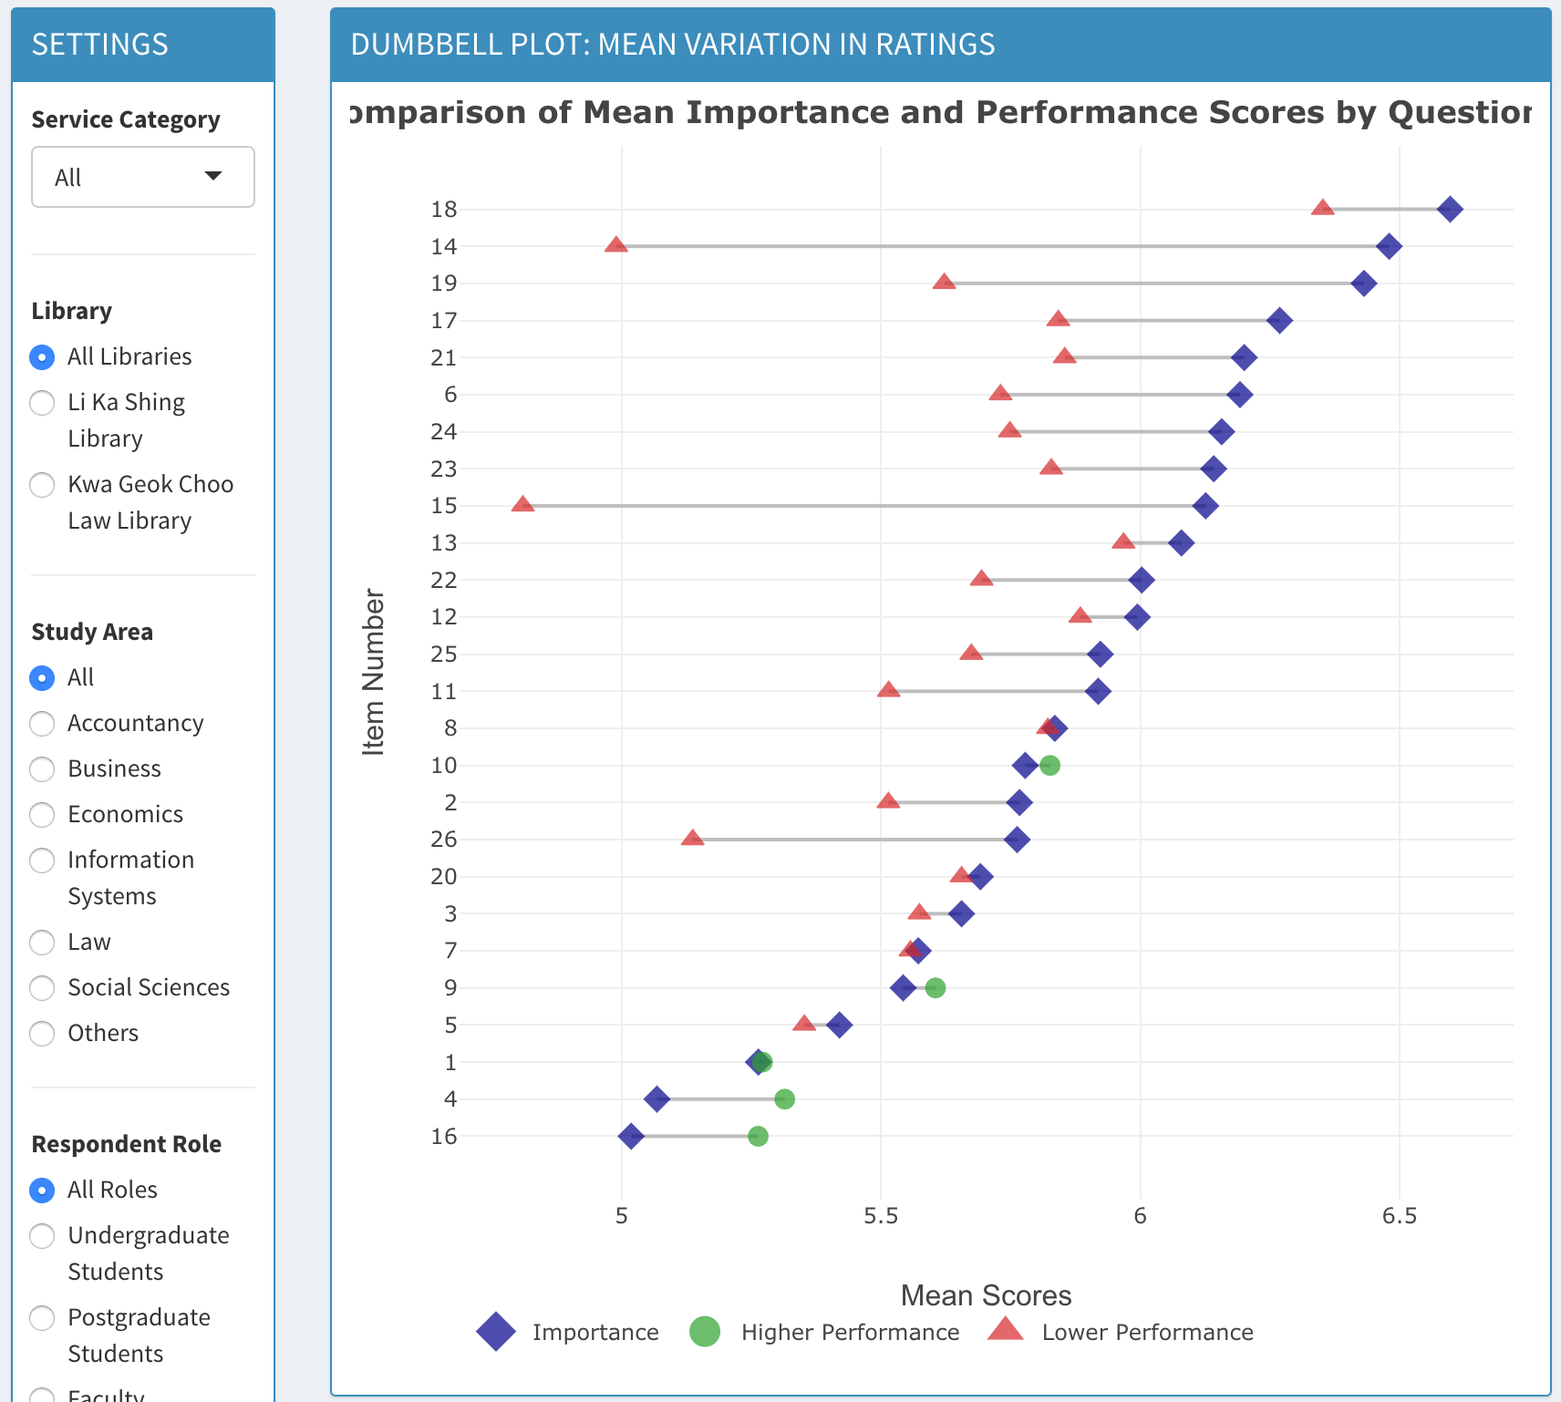
Visualisation - Dumbbell Plot
Instructions for Use:
This chart is a dumbbell plot compares mean performance and improvement ratings and the gap between them, whether it is positive or negative.
Hover over the chart to see values and the whole item wording easily, with calculated score gaps
Click on left to select the type of Library, study area and the type of respondents
Filter according to dimensions of the questions.
Tools for this visualisation are similar to diverging bar charts tools (Fig. 9 – slide 9)
Fig 10. Dumbbell Plot

Slide 11
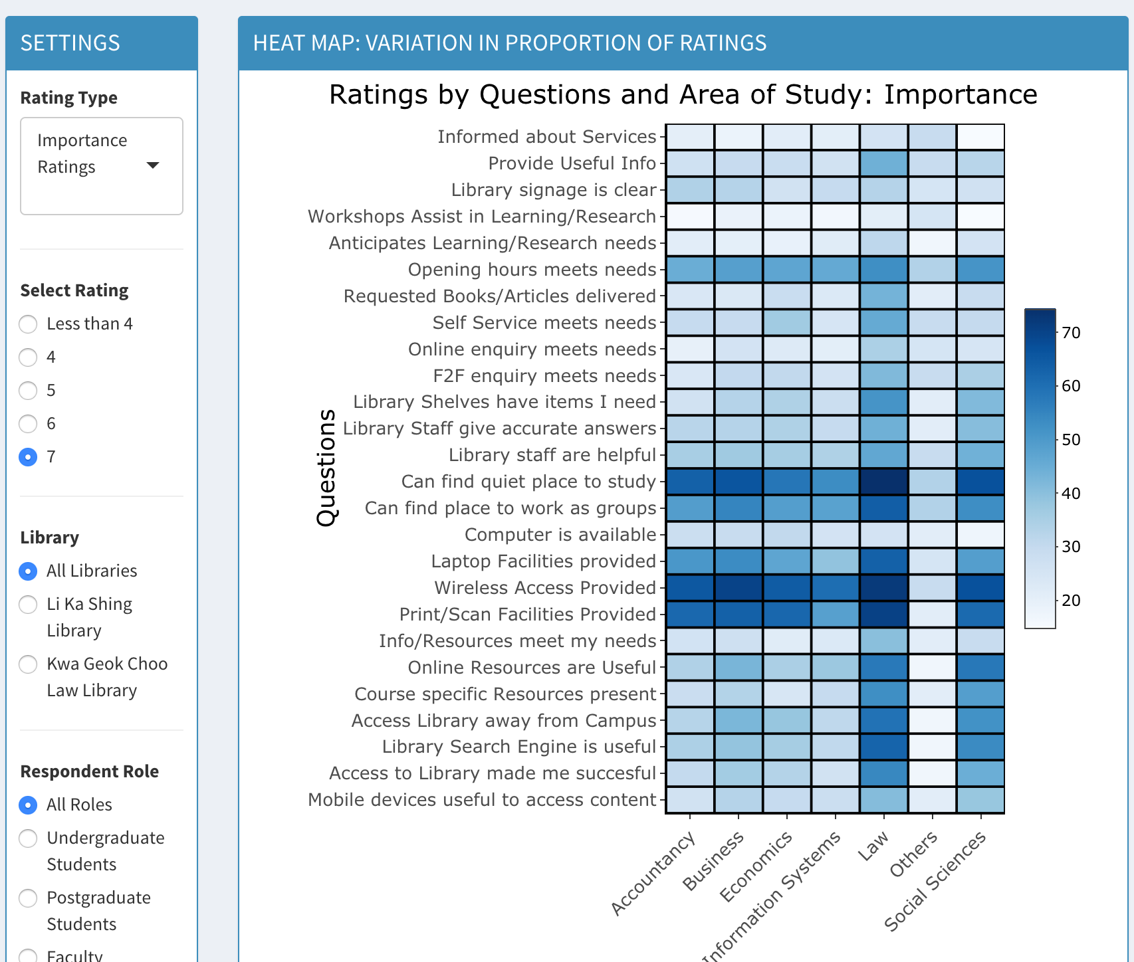
Visualisation - Heat Map
Instructions for Use:
This heat map plot explains the proportions of ratings given by respondents per study area.
Hover over the chart to see values.
Click on left to select the type of Library, study area and the type of respondents.
Select the rating from the left to see the proportion
Filter according to see between Performance and Improvements ratings
Fig 10. HeatMap Plot

Slide 12
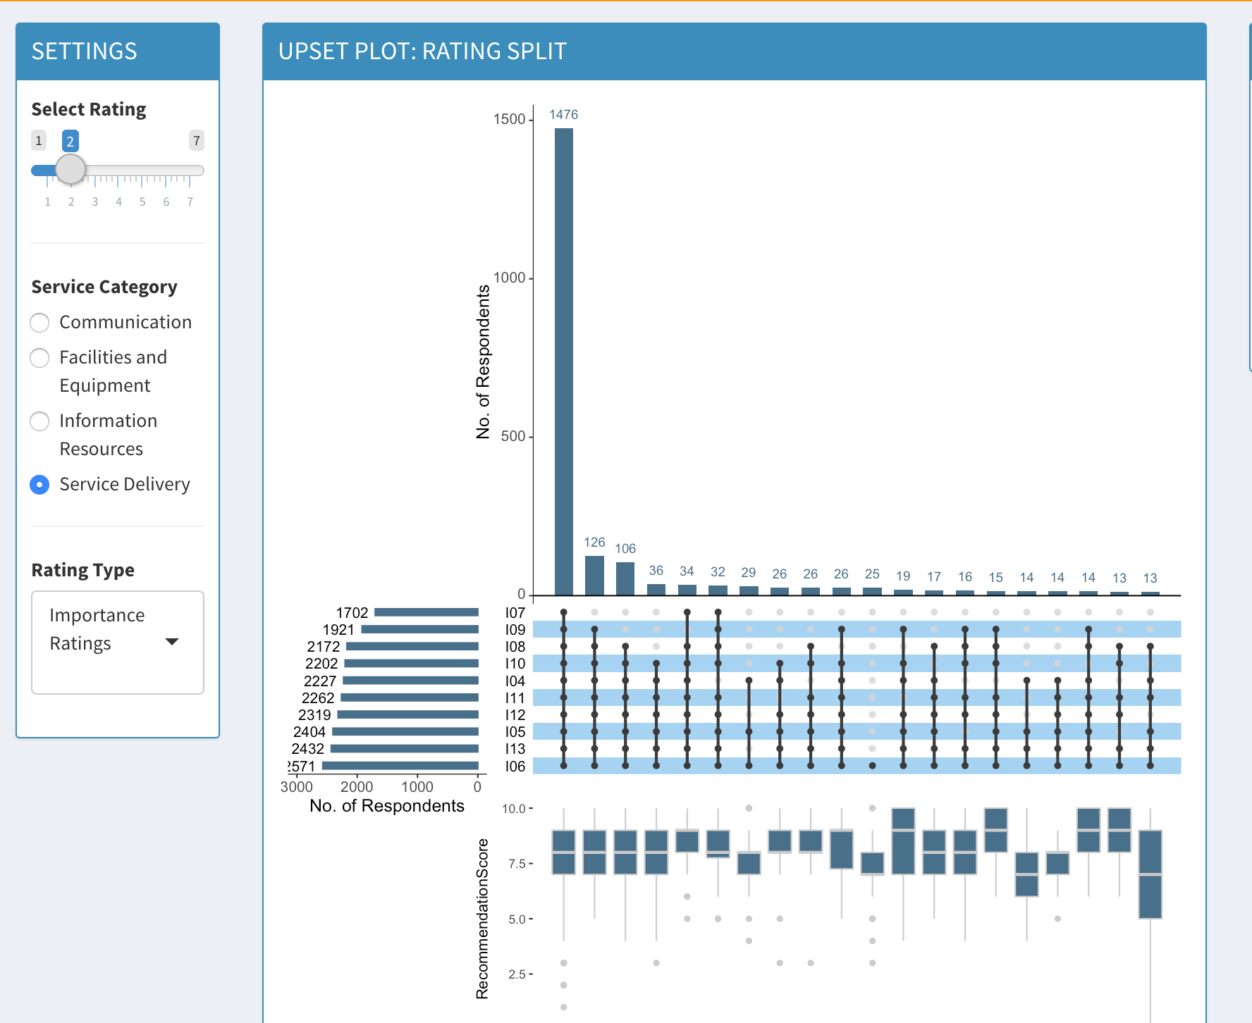
Visualisation - UpSet Plot
Instructions for Use:
This UpSet plot chart explains the the distribution of each rating given by the respondents
Select the dimension (service category) and filter for rating score (e.g. 6), and the application groups respondents according the dimension and rating.
The plot shows you aggregation (number of respondents) at set intersections which have given. Shaded black dots means for that item, the group fulfils rating criteria (e.g. 6 or more). If it is empty, it means for that item the criteria was not fulfilled (in this example, it means the rating is 5 or less).
Boxplot at bottom shows recommendation score distribution for that aggregation group.
Fig 11. Upset Plot

Slide 13
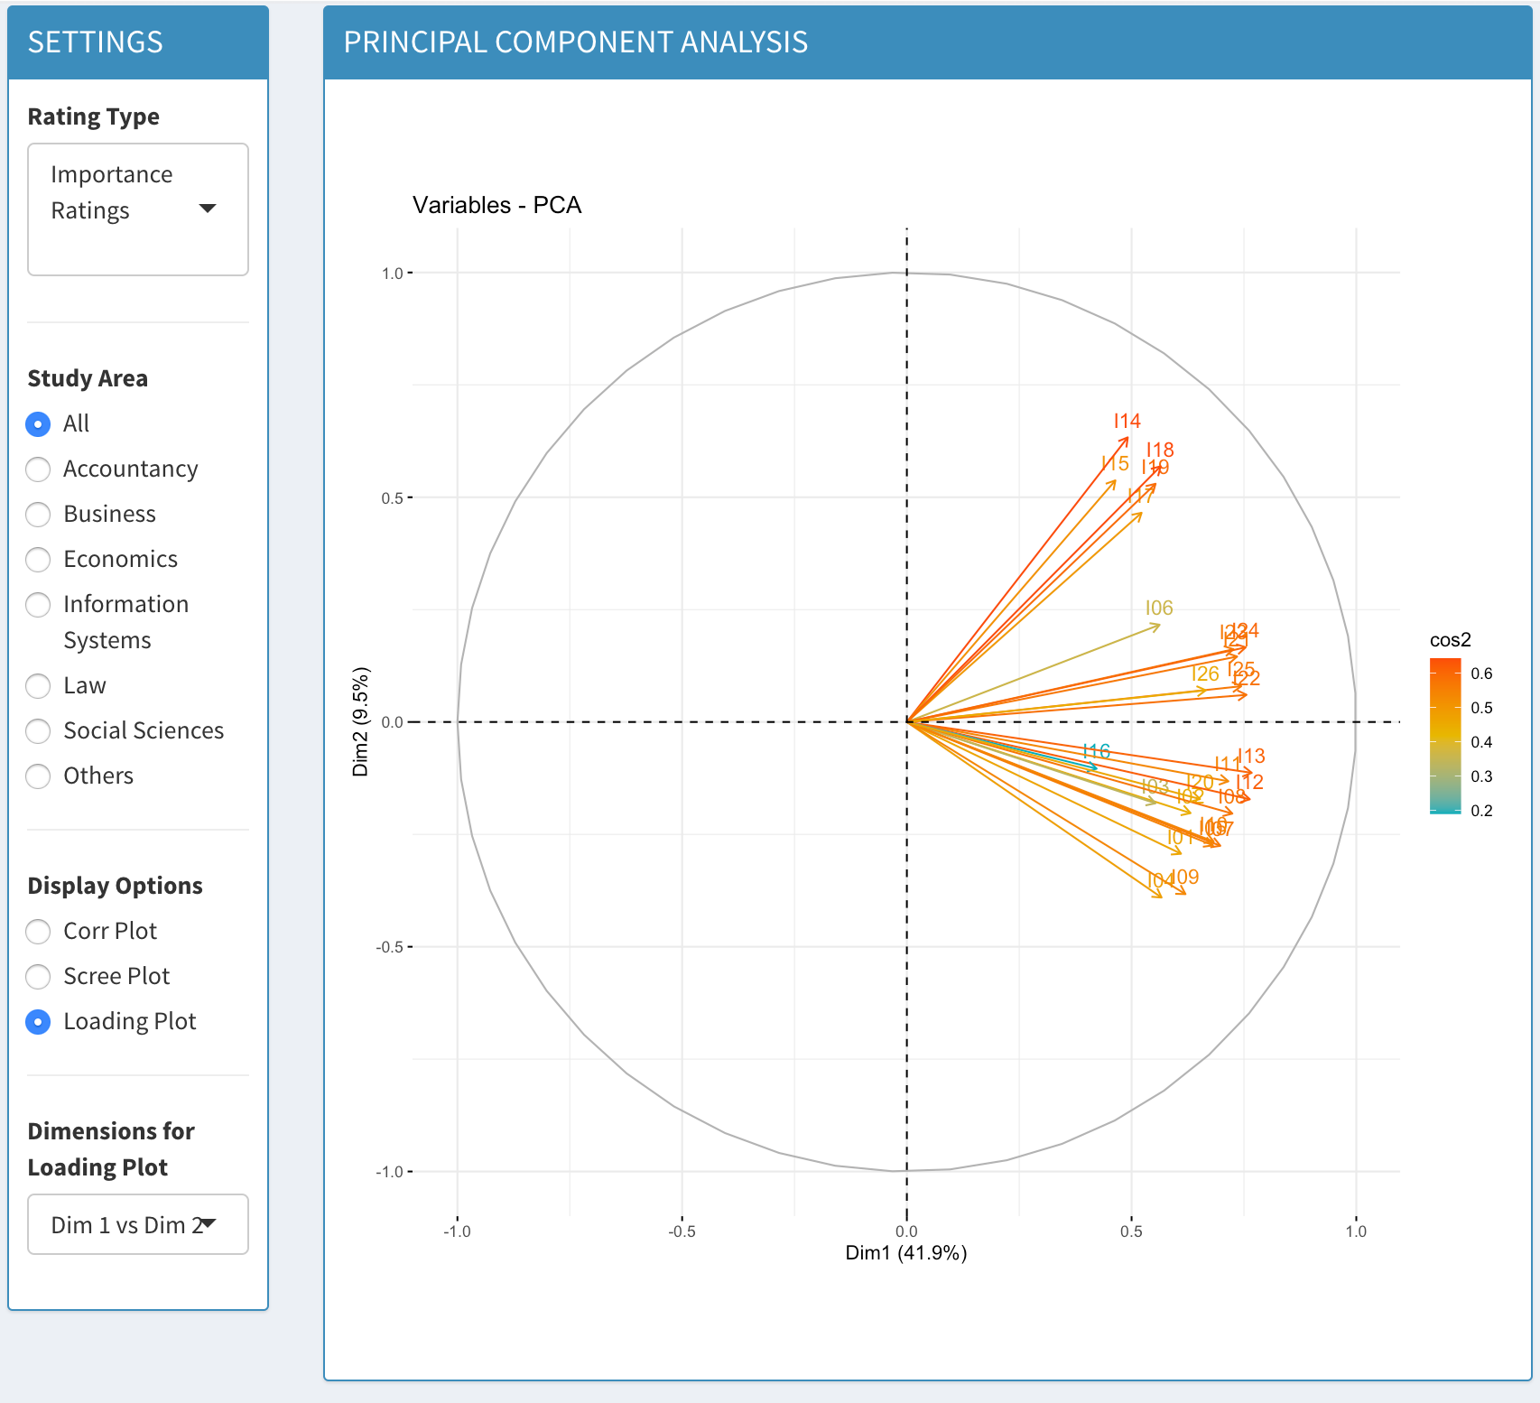
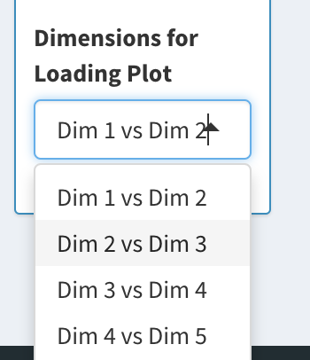
Modelling – Principal Components Analysis
Instructions for Use:
This page has different charts showing the results of the PCA
This is a Loading Plot diagram
Click on left to select the Correlation Plot and Scree Plot
Filter according to select the different dimensions for the loading plot.
Filter accordingly to see between Performance and Improvements ratings
Fig 12. Loading Plot
Fig 13. Option to select different dimensions for Loading Plot

Slide 14
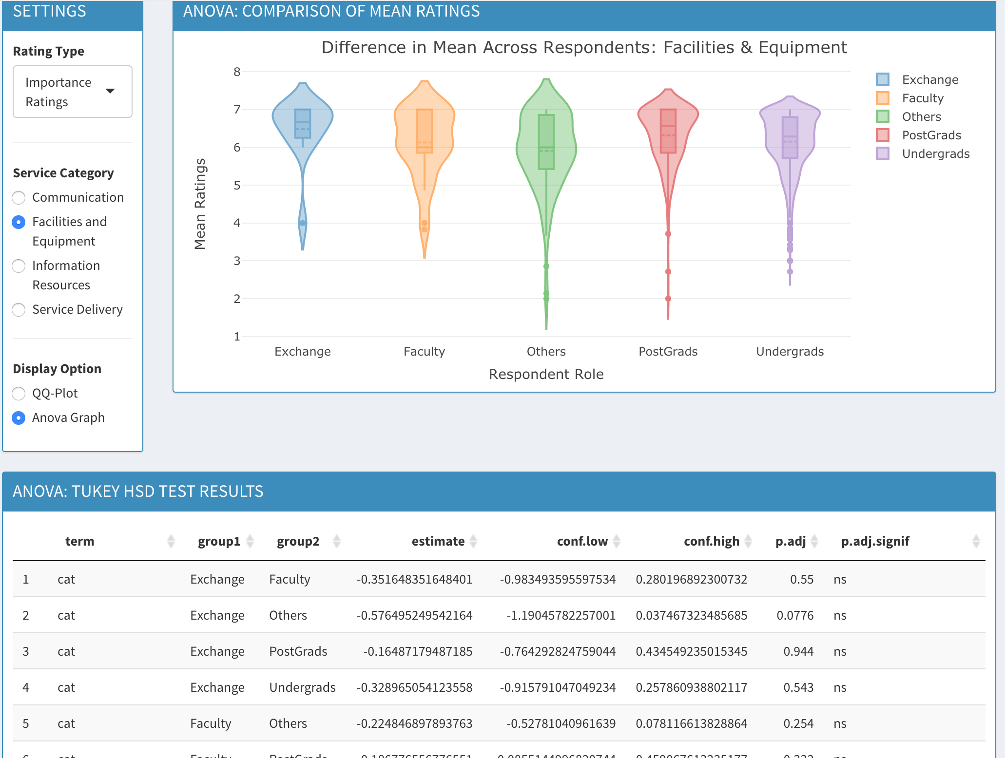
Modelling - Analysis of Variance (ANOVA)
Instructions for Use:
This does shows the graphs to display results of ANOVA
This is Violin Plot showing the comparison of means
Click on left to select the service category
Filter according to select between Performance and Improvement related Questions
Select the QQ-Plot to see the normality results
Fig 13. Violin Plot for comparing means

