Slide 1
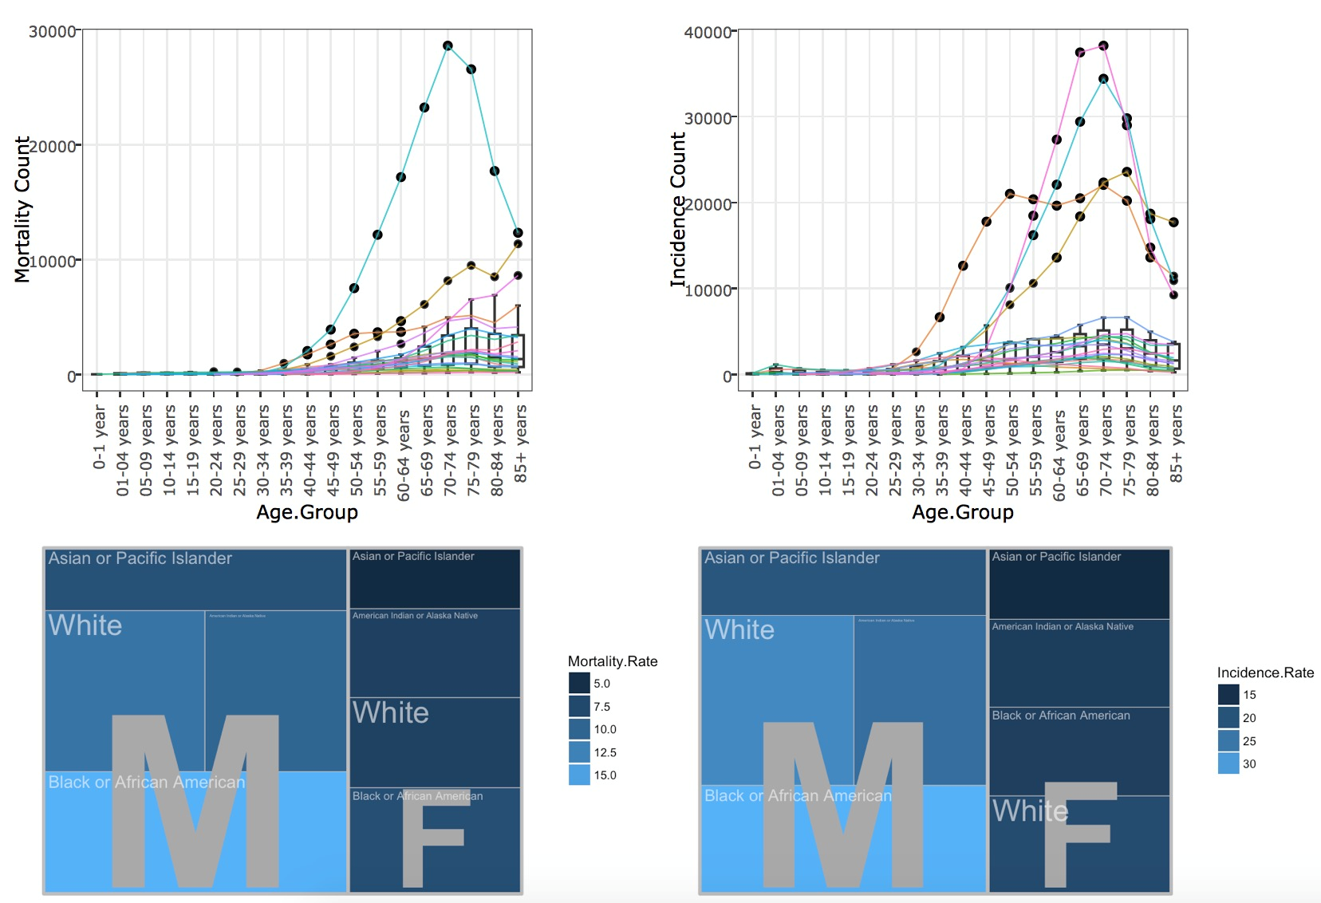
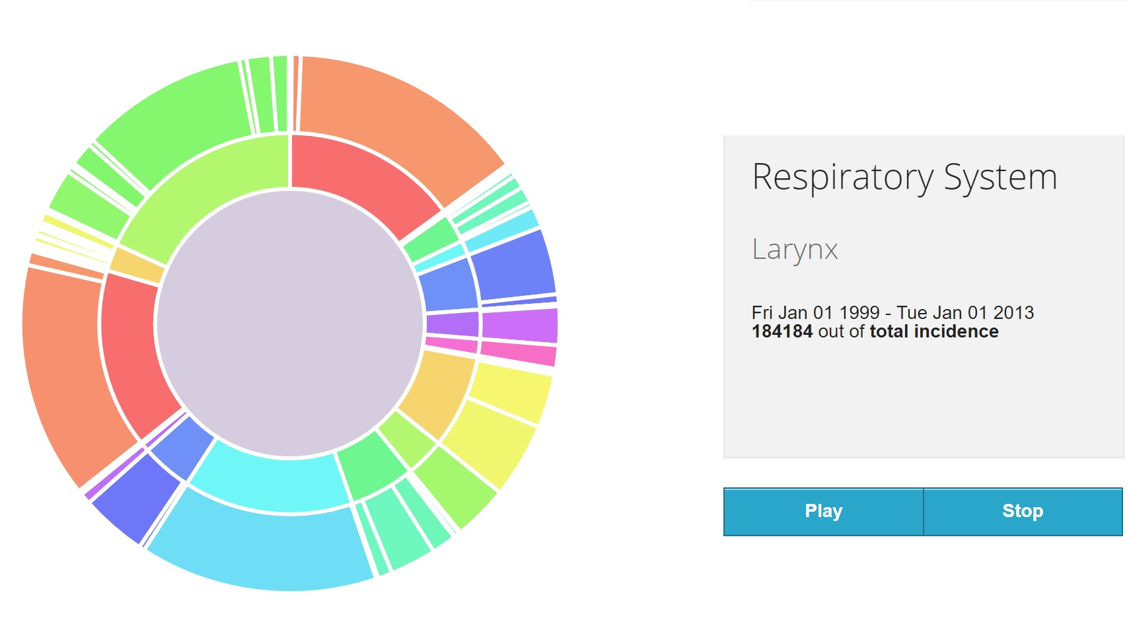
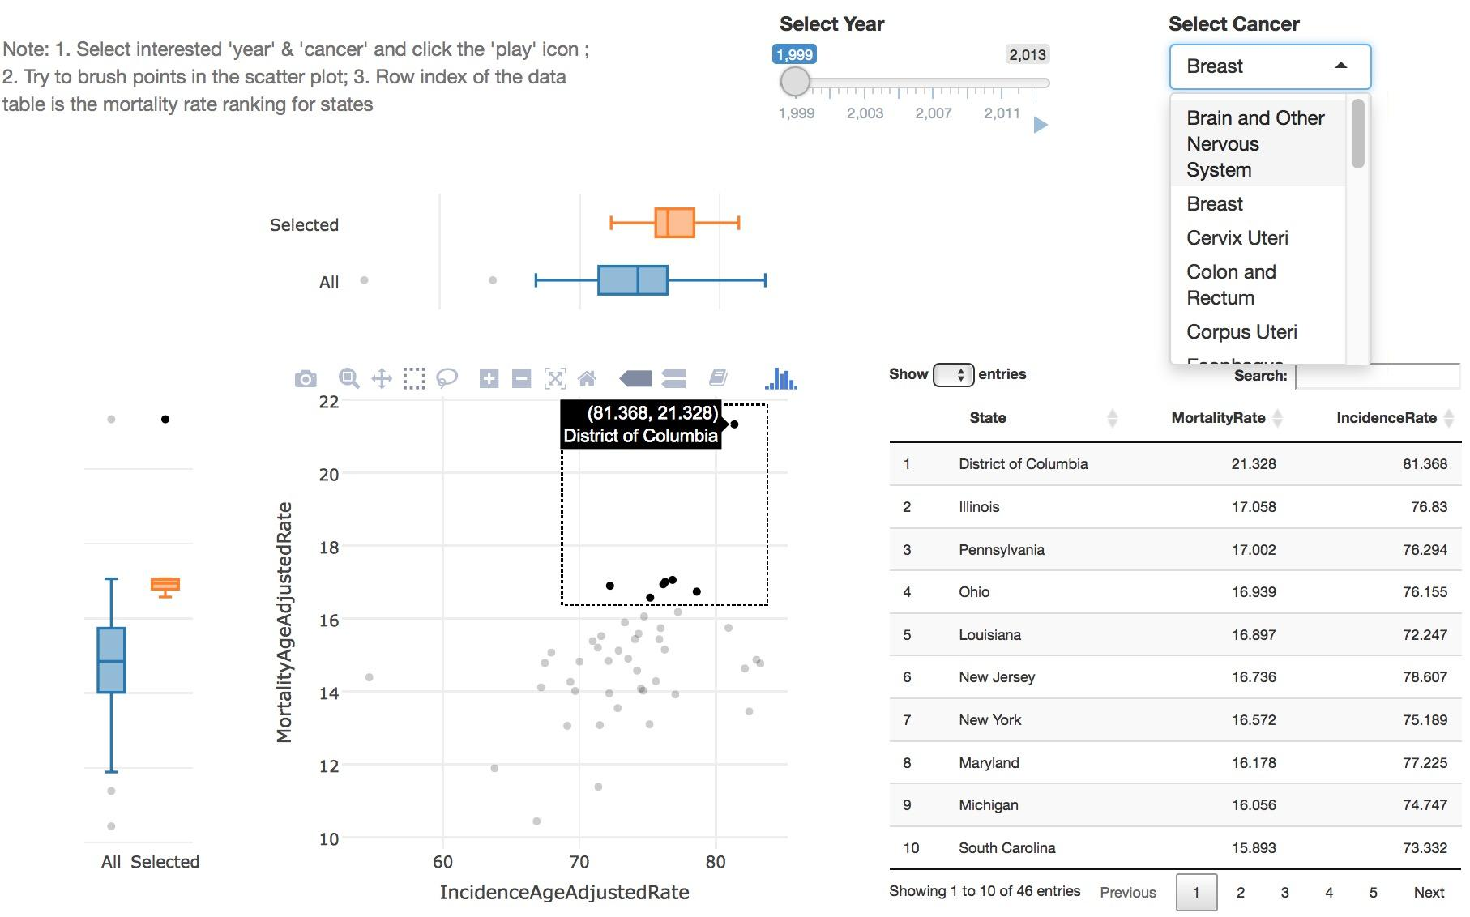
1. Issues And Problems
How Close You are to Cancer
Cancer remains to be an significant cause of death around the world. One among 5 people who passed away is killed by cancer each year in the United States, and the number in the world is 100-350 per 100000.
Kam Tim Seong (Advisor)
LI Dan; WEI Jingxian; ZHANG Zhe
4. Results_1
Lung and bronchus is the primary fatal disease as it shows a significant spike for death counts.
Breast cancer, in terms of death counts, is second to Lung and bronchus cancer. People begin to suffer from it around 25 years old.
Prostate Cancer, though with high incidence count, is a low risk cancer as its death counts only raise slowly after the age 50.
Men has higher mortality age adjusted rate that women. But researchers also don’t know why.
2. Motivation
The dataset is sourced from Centers for Disease Control in USA, see https://wonder.cdc.gov/cancer.html. Variables of our dataset includes ‘Year’, ‘State’, ‘Sex’, ‘Race’, ‘Mortality Rate’, ‘Incidence Rate’, ‘Cancer Sites’, etc.With the dataset, it is intended to explore various cancer-related features to offer guidance for cancer prevention and treatment at a high level.
3. Approach
A sunburst diagram is built using D3.js is used to identify hierarchical, proportional relationship between leading cancer sites and its sub categories. It also shows how the relationship changes over time.
A dashboard is created using R Shiny library to enable users to interactively exploring the geographic and demographic features of cancers.
4. Results_2
As for the incidence counts of leading cancer sites, digestive system (3,935,477) ranks first, followed by respiratory system (3,296,761).
The top 3 in sub-category are female breast (3,094,550), prostate (3,096,329) and lung and bronchus (3,070707), respectively.
Tobacco use is the single most important risk factor for cancer causing about 20% of global cancer deaths and around 70% of global lung cancer deaths.
5. Future Work
4. Results_3
The Visualisation of this project is mainly descriptive analysis with statistical measures. With more variables, such as weight, diet, living habits or jobs of cancer patients,to be collected in the future, it is possible to apply machine learning algorithms to accurately predict the chances of people getting infected by certain cancers. In this way, people should be alert to take prevention before cancers get to them.
Depending on the the kinds of information needed, other interactive plots can be created to look at the data at different perspectives.
Both Incidence age adjusted rate and mortality age adjusted rate have experienced overall downward trends over the 15 years.
District of Columbia and Wyoming have been leading in terms of Mortality age adjusted rate from 1999 to 2013.

