Slide 1
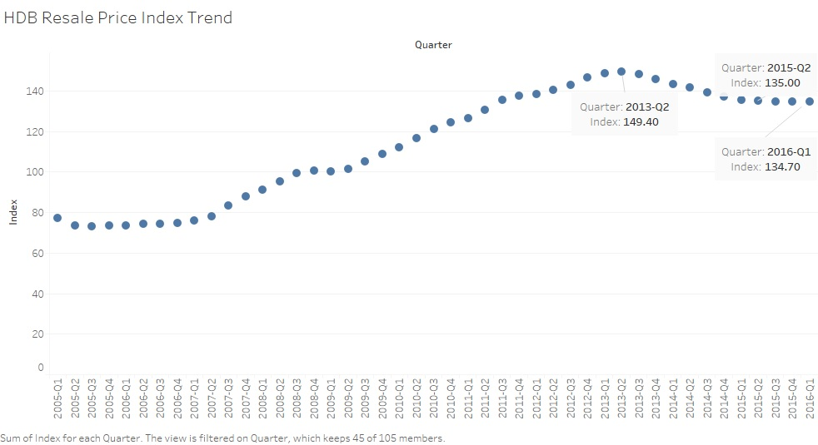
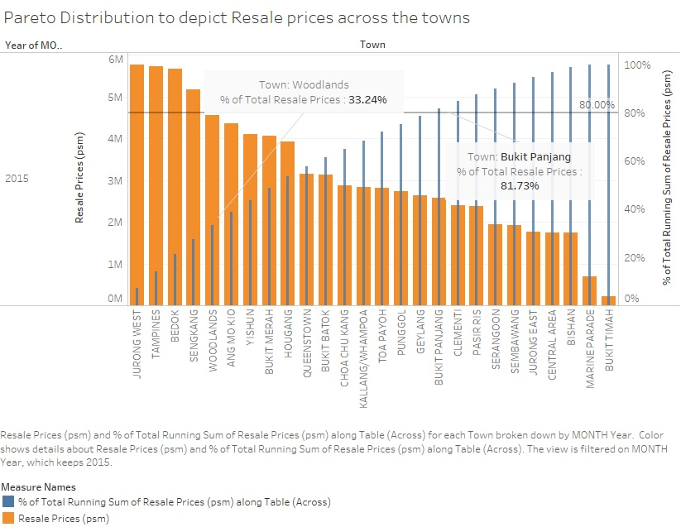
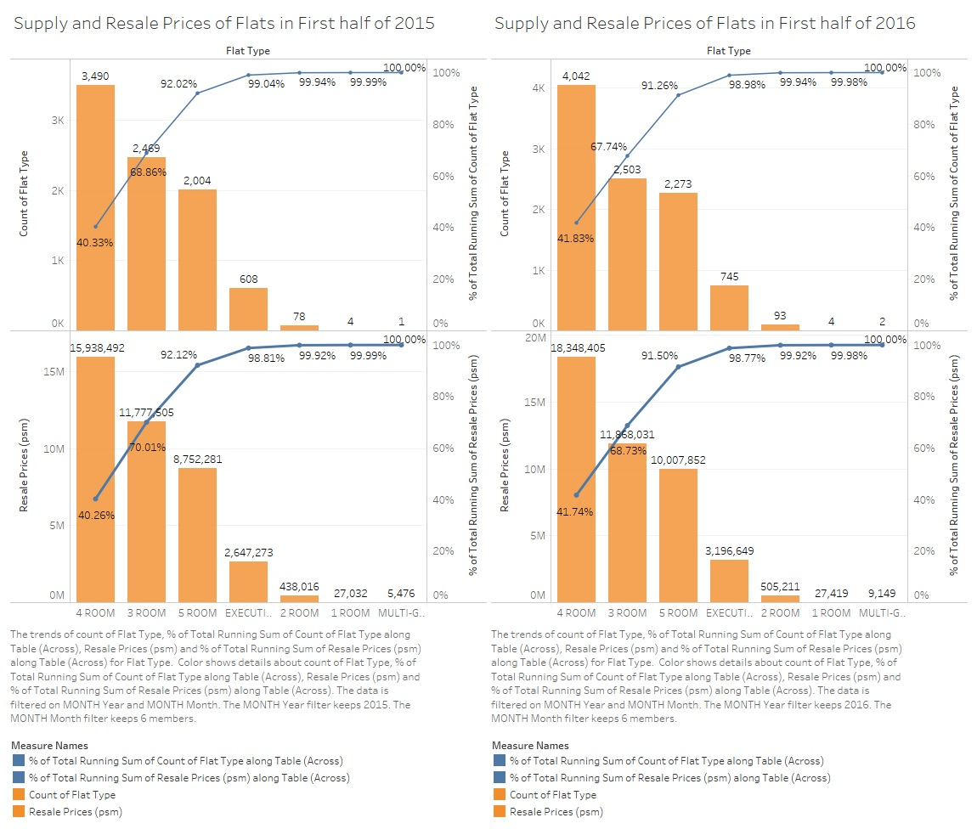
Trends in Resale Prices for Public Housing Supply
The graph shows Resale price Index trend for the previous 10 years.
The index is based on quarterly average resale price by date of registration.
--------------------------------------------------
The above graph shows the Pareto distribution for the major contributing towns regarding the resale price. From the graph, we get an insight that the 5 towns, namely Jurong-West, Tampines, Bedok, Sengkang and Woodlands contribute to the resale prices and thus are the major towns for the resale market.
------------------------------------------------------------------------------------------------------------------------------------
The above graph uses the data of first half of 2015 and 2016. The Pareto chart depicts that the trend is quite similar over the flat types in both years. However, there is a slight increase in demand for the 4-room flat in the year 2016 as compared to that of 2015. The next Pareto chart shows that the resale price for 5-room flat has increased gradually in 2016 as compared to those in 2015.

